Slide 1

Host and symbiont physiology during wound regeneration in fragmented and abraded Acropora pulchra under heat stress.
Ninah Munk Adrian
Notes:
Hi everyone, thank you all for being here. Thank you Adrian for that introduction. Two years ago, I came to Santa Barbara to join the ocean recoveries lab and continue studying coral resilience and today I’m here to share with you all how I’ve pursued that. I want to start my presentation off today with a story.

Slide 2



Notes:
The story starts in 1997, so let’s first go back in time. In case you weren’t born yet at that point like myself, or maybe your memory is a bit hazy, I will give you some context about what was going on at the time…

Slide 3




Notes:
In 1997, Harry Potter and the Philosopher’s Stone by J.K. Rowling was published. Also, the US space probe, Pathfinder, lands on Mars for the first time. And a personal favorite of mine, The Crocodile Hunter, starring Steve Irwin, debuts. Actually, I’m sure you all knew that already, but what you might not recall unless you are a coral reef scientist or ocean enthusiast.

Slide 4
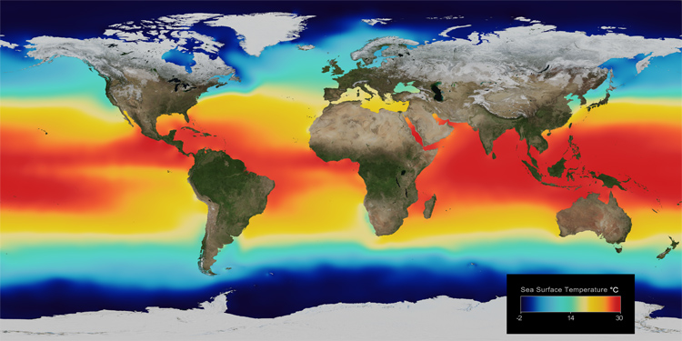
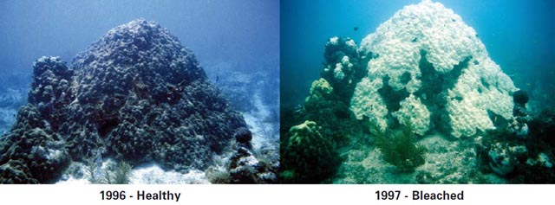
Notes:
Is that 1997 through 98 was an El Nino year, and ocean temperatures got very warm and stayed warm for a long time. It resulted in the first ever recorded global mass coral bleaching event and it impacted coral reefs around the world.

Slide 5
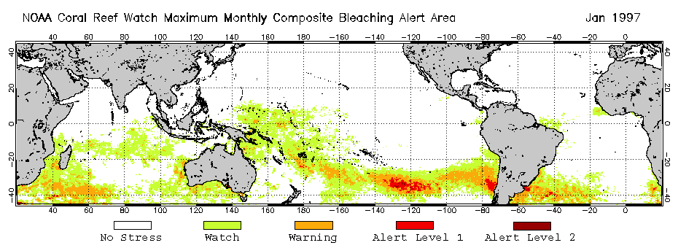
Notes:
E l nino

Slide 6
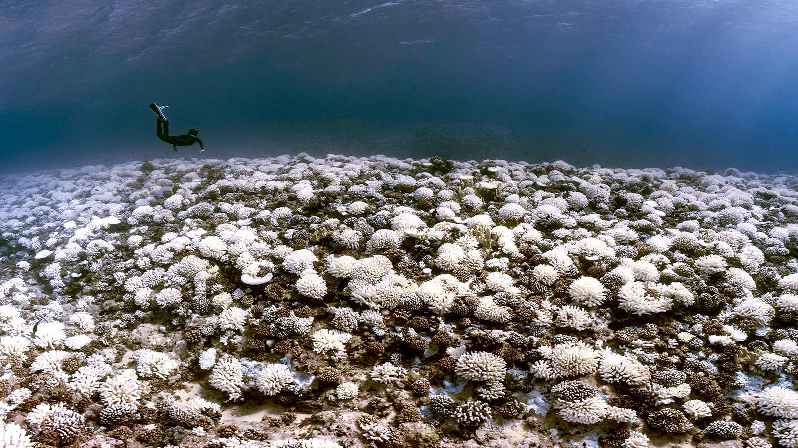

Slide 7
Notes:
And unfortunately, this event resulted in a loss of at least 15% of the worlds coral reefs.

Slide 8
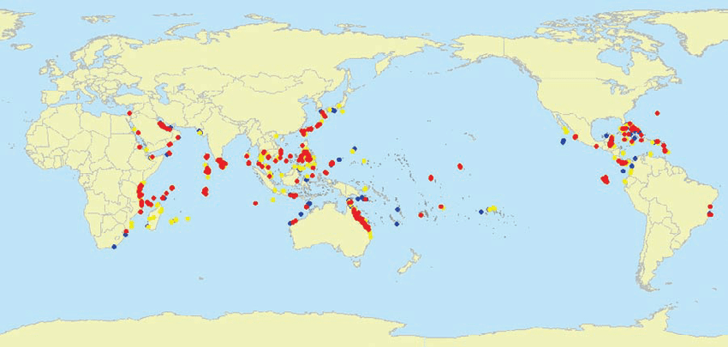
Spillman et. al., 2011
Notes:
Is that 1997 through 98 was an El Nino year, and ocean temperatures got very warm and stayed warm for a long time. It resulted in the first ever recorded global mass coral bleaching event and it impacted coral reefs around the world. This map shows all the reefs which were impacted.

Slide 9
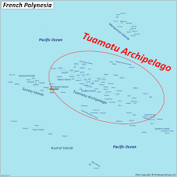
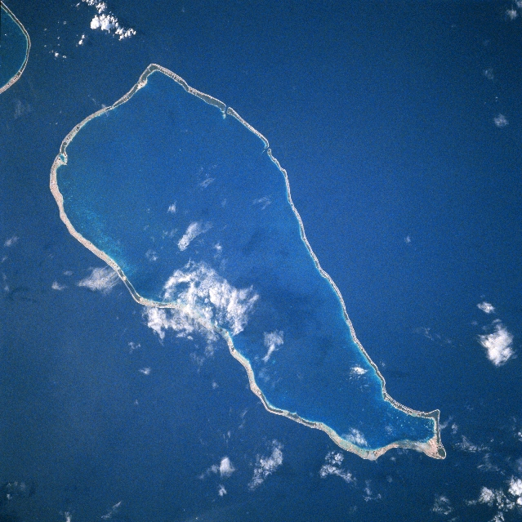
Spillman et. al., 2011
Notes:
The dots in this map represent all of the reef which were impacted during this mass bleaching. Unfortunately, this resulted in a loss of at least 15% of the worlds coral reefs. To take a closer look at this event, I want to in to zoom to the south pacific, to a specific atoll in French Polynesia called Rangiroa during this 1997-98 global coral bleaching event. On the inside of this atoll within the lagoon, at a site called motu tivaru, there was an assemblage of massive corals, of the genus Porites.

Slide 10
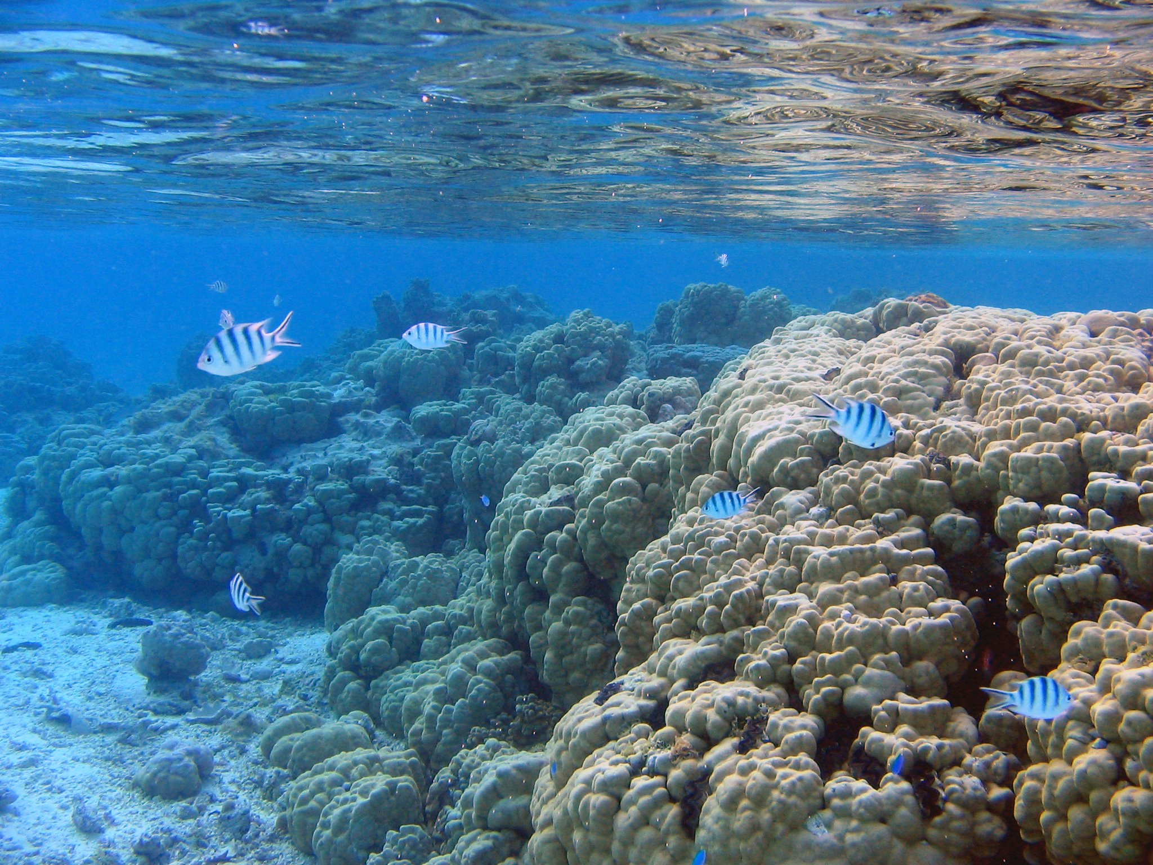
Notes:
The terms used to describe this assemblage of Porites were dominance and longevity, because of their massive sizes and estimated ages which were for some over 400 years old. So in 1998, after the global bleaching event, researchers documented that dominant assemblage of Porites to look like this:

Slide 11
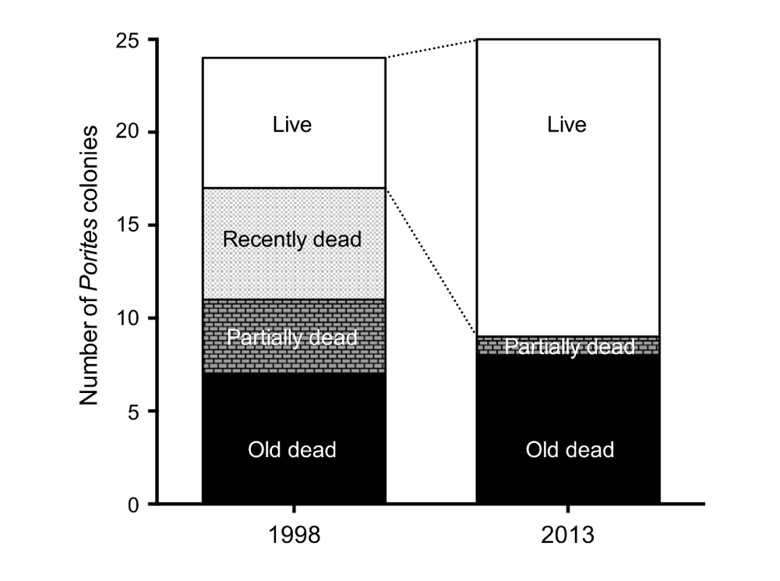
Roff et. al., 2014
Notes:
Here you’re looking at a survey from 1998 which described the proportion of Porites colonies categorized into live (more than 80% living tissue), recently dead (less than 19% living tissue), partially dead (20-79% living tissue), and old dead (which was just eroded substrate). Interpreting this a coral scientist, the future of Porites as the dominant assemblage at Tivaru looked bleak, and if that large proportion of recently dead corals from the bleaching event were to be restored, it would take a very long time. However, the same exact Porites assemblage was resurveyed in 2013, just 15 years later. And the assemblage looked like this:
What researchers found was that the proportion of live tissue more than doubled, and there were no colonies categorized as recently dead. So, wow, this recovery is just as unprecedented as the mass bleaching event that preceded it. What’s going on here? The key attribute that these Porites had, was a remarkable ability to regenerate. Specifically, the authors of this study report that the mechanism for this rapid recovery is tissue regeneration, where remnant surviving tissue rapidly recolonized recently dead skeleton. This phenomenon is coined the phoenix effect.

Slide 12
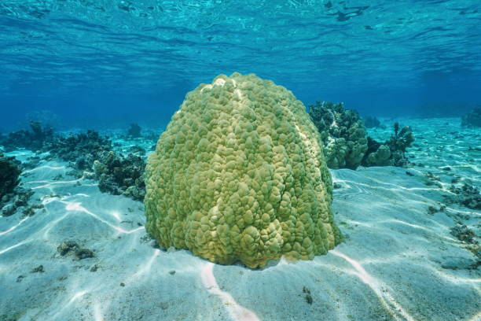

Notes:
This phenomenon is coined the phoenix effect.
While this phoenix effect phenomenon was brought into the mainstream by large scale bleaching events, coral regeneration is a key component of coral resilience that occurs in response to more frequent and smaller scale disturbance. Furthermore, despite how remarkable this mechanism of coral recovery appears to be, it is a quite understudied aspect of coral resilience. What we do know is that Stony corals routinely manage sublethal tissue and skeleton removal, and they don’t succumb to death.

Slide 13
Introduction
Methods
Results
Conclusion
Notes:
While brought into the mainstream by large bleaching events, tissue regeneration is a key component of coral resilience that occurs in response to more frequent smaller spactial scale disturbances and Tissue regeneration occurs on more frequent time scales

Slide 14
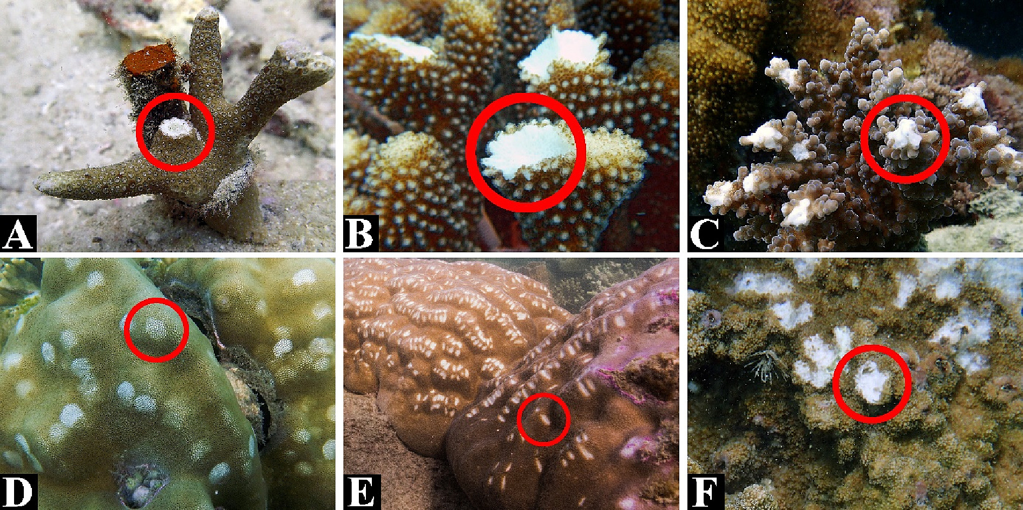
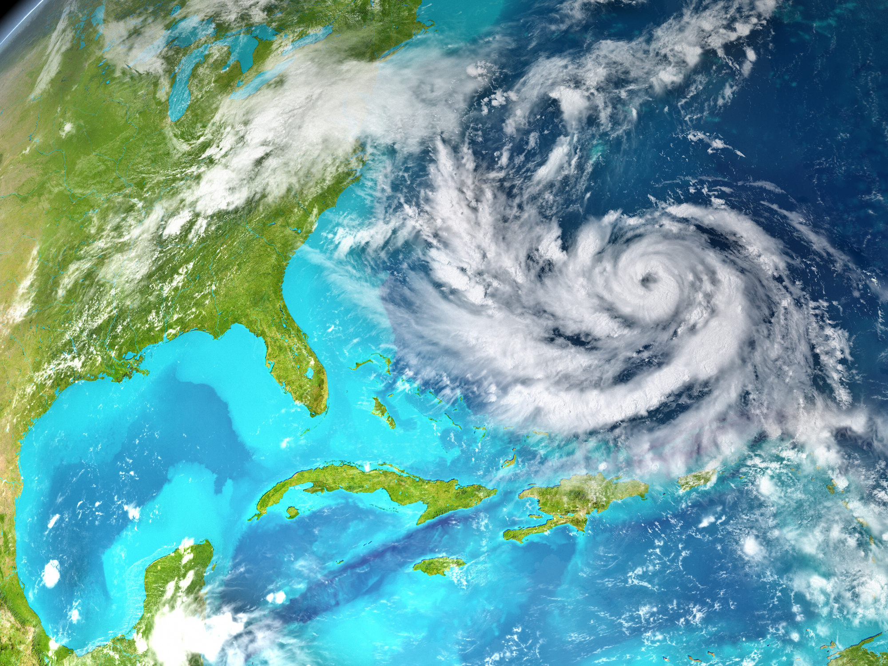
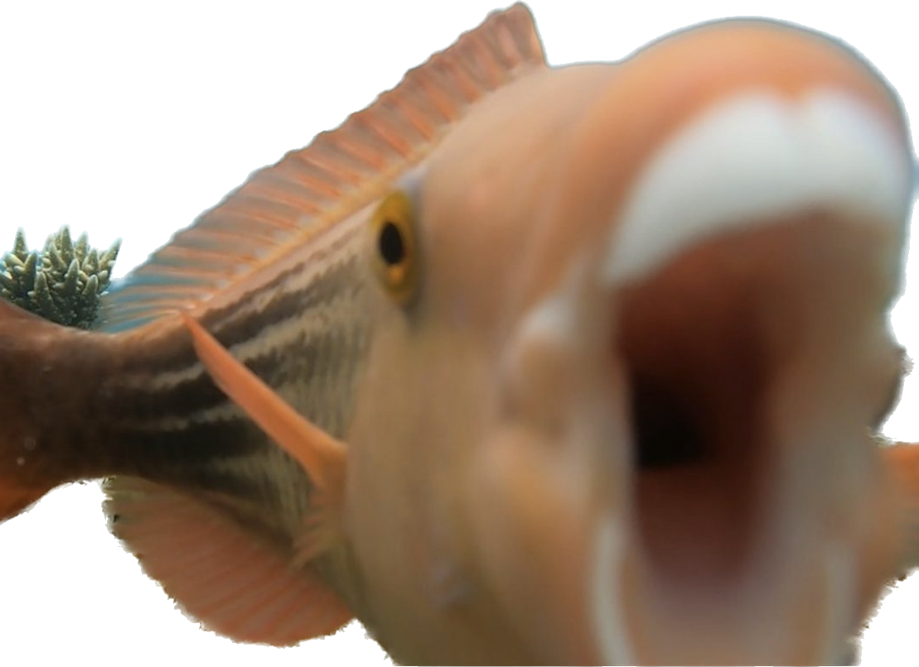
Knoester et. al., 2014
Notes:
For example, corallivorous fish continuously scrape at coral tissue or remove entire branches. Intense wave action during storms is another mechanism for mechanical damage to coral colonies.

Slide 15
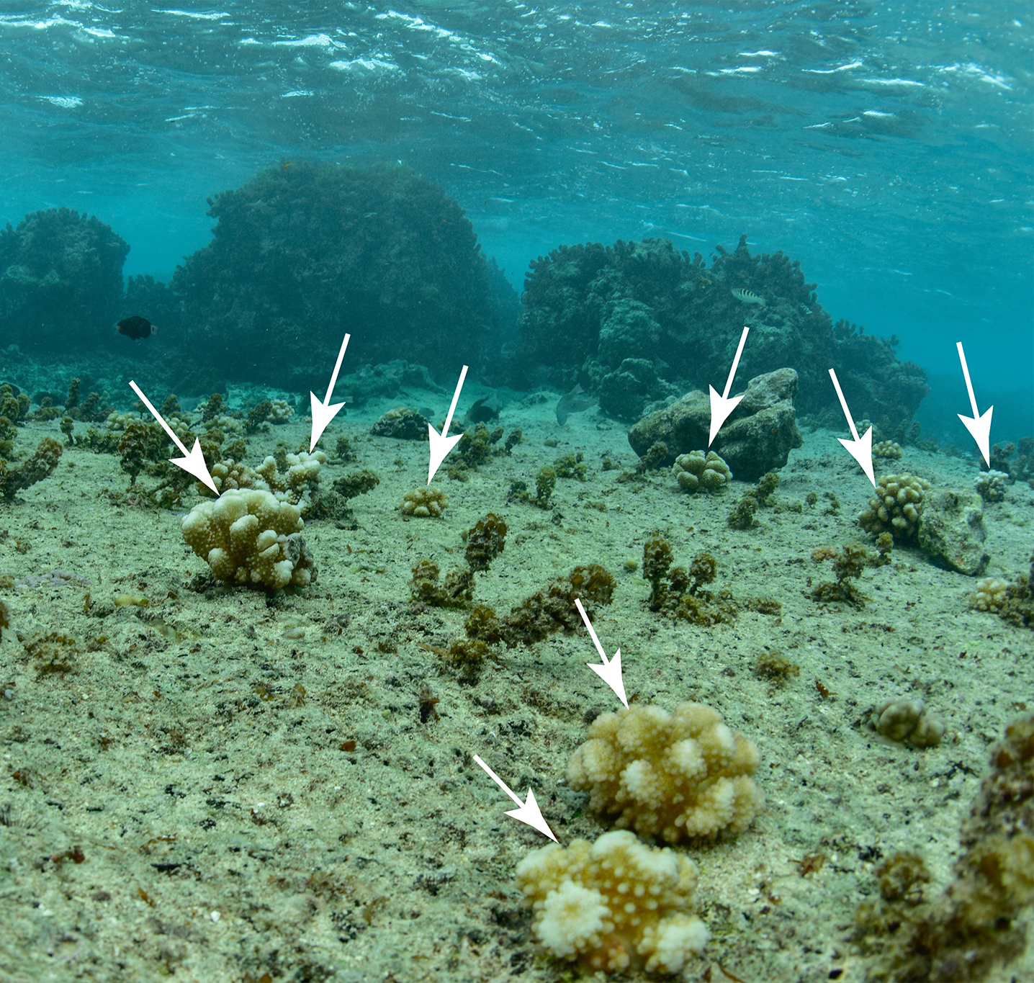
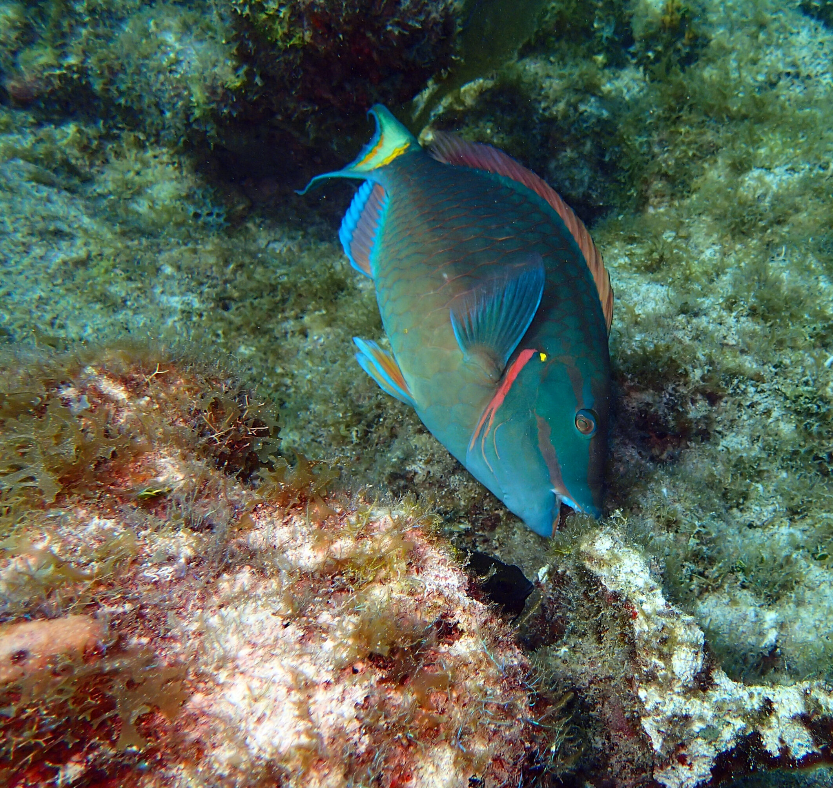
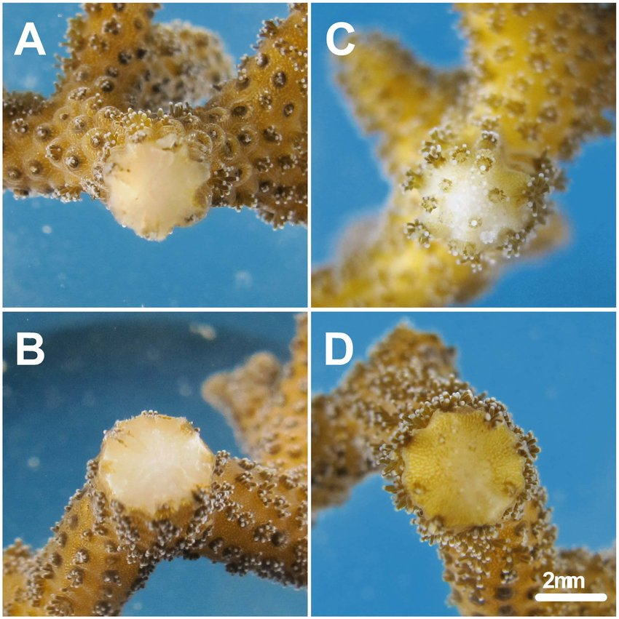
Introduction
Coral tissue regeneration
Edmunds et. al., 2017
Coral recruitment
Herbivory/grazing
Notes:
Which leads me to introduce the project I’ve carried out over the last two years. Most of us when we think of coral recovery after some disturbance we think of new coral recruitment via larval supply to restore a degraded area. We also think about mechanisms to support this recruitment such as herbivory to reduce competition for space with macroalgae. However, there is another mechanism, which is highlighted well by the story I described, where corals can regenerate themselves from disturbance and that starts with regenerating tissue.

Slide 16
Introduction
Wave action
humans
Herbivory/grazing
Notes:
Which leads me to introduce the project I’ve carried out over the last two years. Most of us when we think of coral recovery after some disturbance we think of new coral recruitment via larval supply to restore a degraded area. We also think about mechanisms to support this recruitment such as herbivory to reduce competition for space with macroalgae. However, there is another mechanism, which is highlighted well by the story I described, where corals can regenerate themselves from disturbance and that starts with regenerating tissue.

Slide 17
Introduction
Notes:
The concept of remarkable coral regeneration is not new. There are many animals within the same phylum as stony corals, cnidaria, which have regenerative capabilities. For example, the freshwater hydra is a model organism in regenerative science because it can regenerate any small dissociated piece of its body into a complete animal. However, regeneration of colonial organisms including stony corals, is less understood.

Slide 18
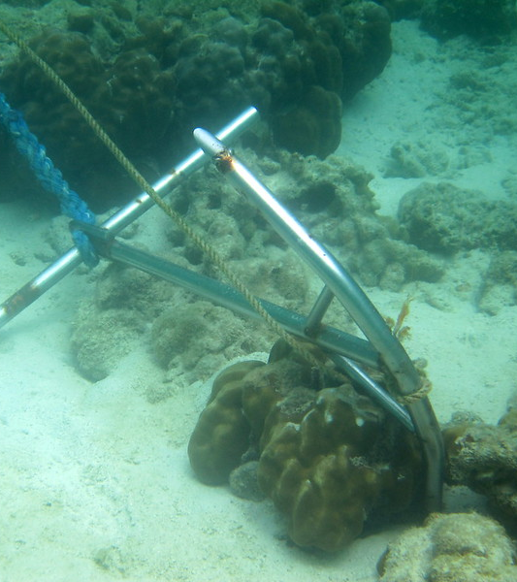
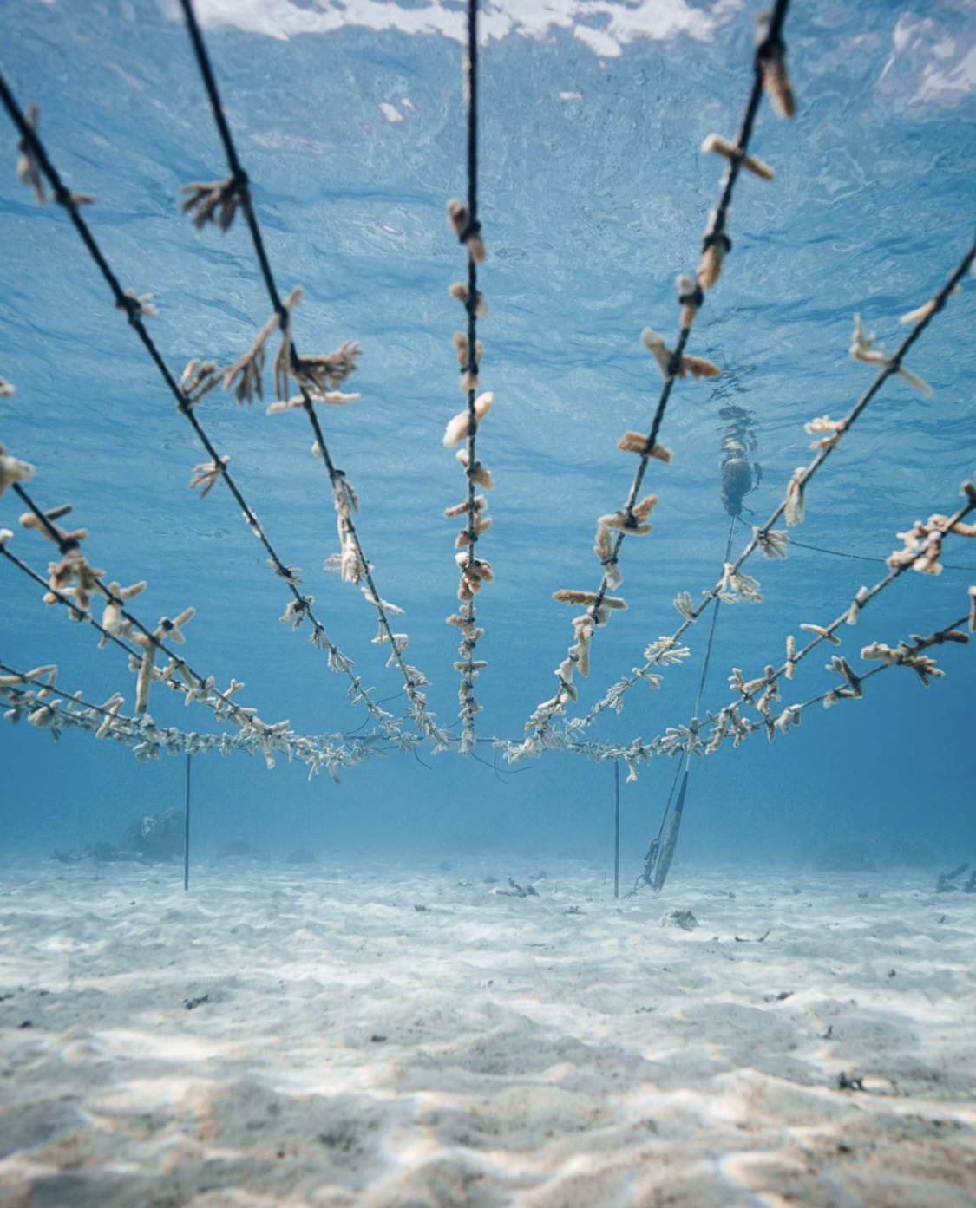
Notes:
Humans are also another source of physical damage, not only in recreational boating or diving accidents, but also in restoration practices. To date coral restoration programs have largely relied on the innate regenerative ability of corals to heal wounds created by propagating corals fragments to then outplant on the reef.

Slide 19
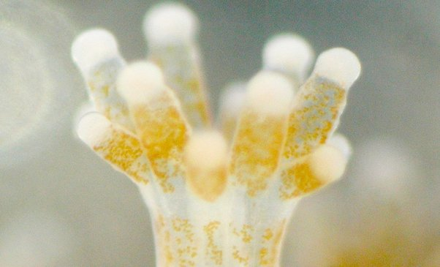
Notes:
While the coral regeneration process is still largely understood, we know that it requires significant energy to regenerate lost tissue and skeleton. The primary way corals acquire energy is through a symbiotic relationship with algae that live in their tissue. The coral supplies resources like nitrogen to the algae and in return the algae supply energy to the coral that they generate through photosynthesis. So the corals are receiving these energy rich resources and some of it is going to regeneration but corals have a larger energy budget than that. You can think of it as similar to having a job and when you receive money from your job you can’t put it all towards rent, you have several things you need to use that money for.

Slide 20

Notes:
Understanding energy acquisition and how that energy is allocated to different parts of the coral energy budget is essential for realizing the ability of coral to regenerate after different wounding events.

Slide 21
Notes:
Connecting back to the story I opened with, tropical corals live near the upper threshold of their temperature range and in many parts of the world corals are consistently exceeding that threshold during the warmest parts of the year. The symbiosis that corals maintain with their photosynthetic algae is very sensitive to heat stress, and the uncoupling of that symbiosis is detrimental to a corals energy budget and therefore survival. And it’s not just large spikes in temperature that cause harm to corals, but increasingly warmer sea surface temperatures due to climate change can also compromise this energy budget and therefore regeneration.

Slide 22
How does temperature, specifically ocean warming temperatures, influence the regenerative capacity of corals?
Notes:
So that leads me to this outstanding question: how does temperature, specifically ocean warming temperatures, influence the regenerative capacity of corals?

Slide 23
H1: Regenerative capacity decreases under warmer temperatures
H2: Regenerative capacity is dependent on wound characteristics.
H3: Regeneration comes at the cost of growth.
Notes:
I hypothesized that 1: regenerative capacity decreases under warmer temperatures
Mechanistically I anticipated this would happen by warming temperature disrupting energy acquisition and therefore increasing the cost of regeneration. I also hypothesized that regenerative capacity is dependent on wound characteristics. Given the variability in injuries that corals commonly experience, the resulting wound characteristics are likely a defining factor of regenerative capacity. Finally, I hypothesized that regeneration comes at the cost of growth. With the prediction that this trade off would be exacerbated at warmer temperature.
***are these okay to say hypothesis?*** or predictions?

Slide 24
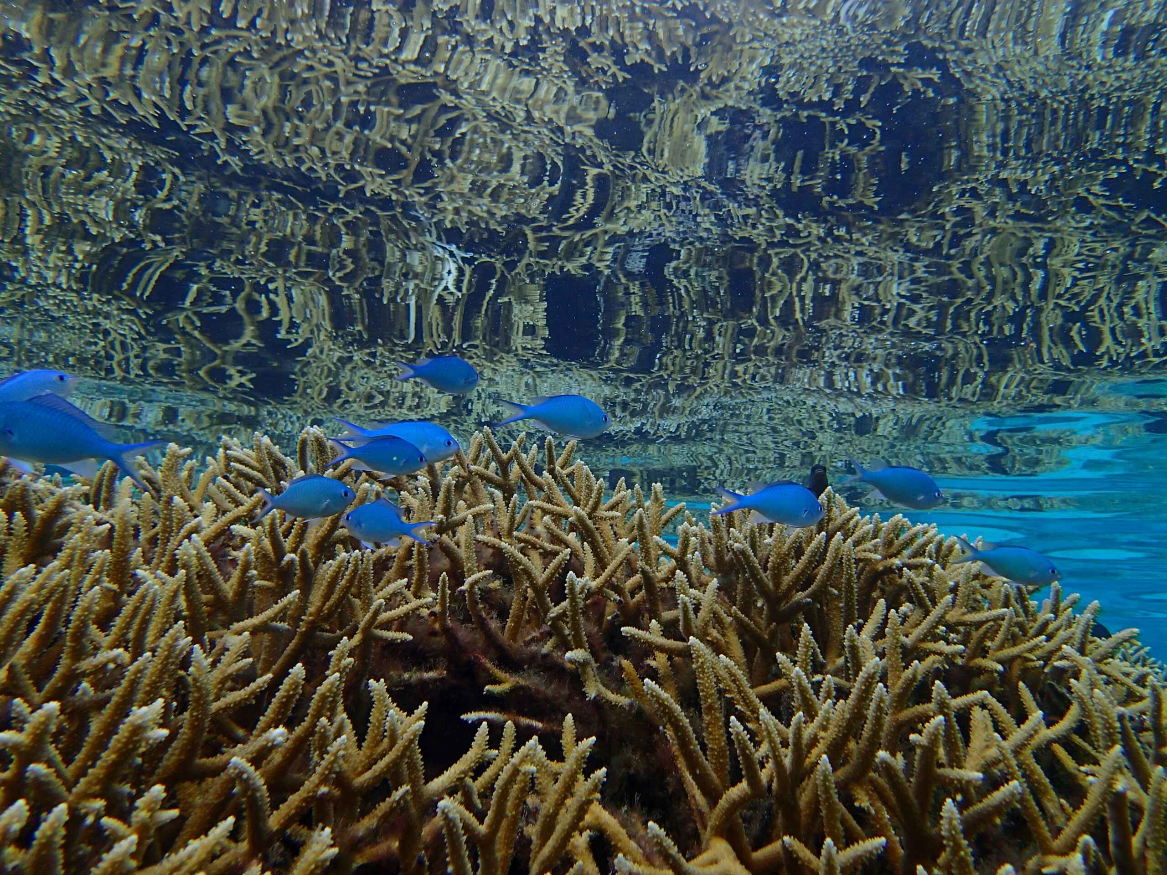
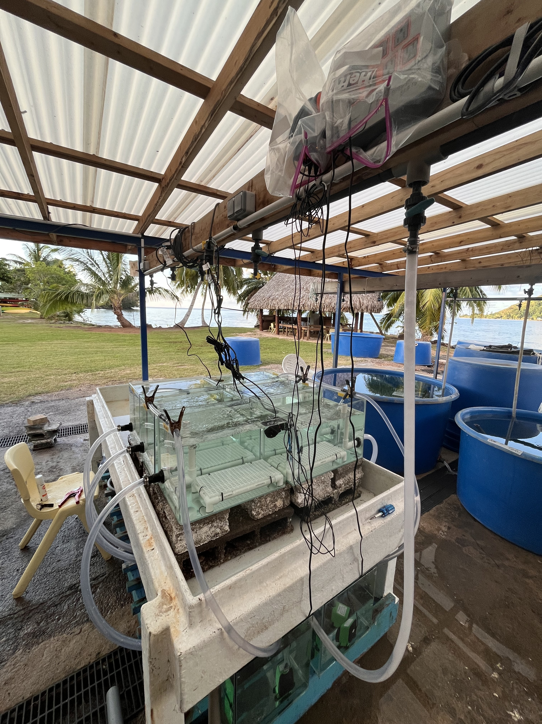
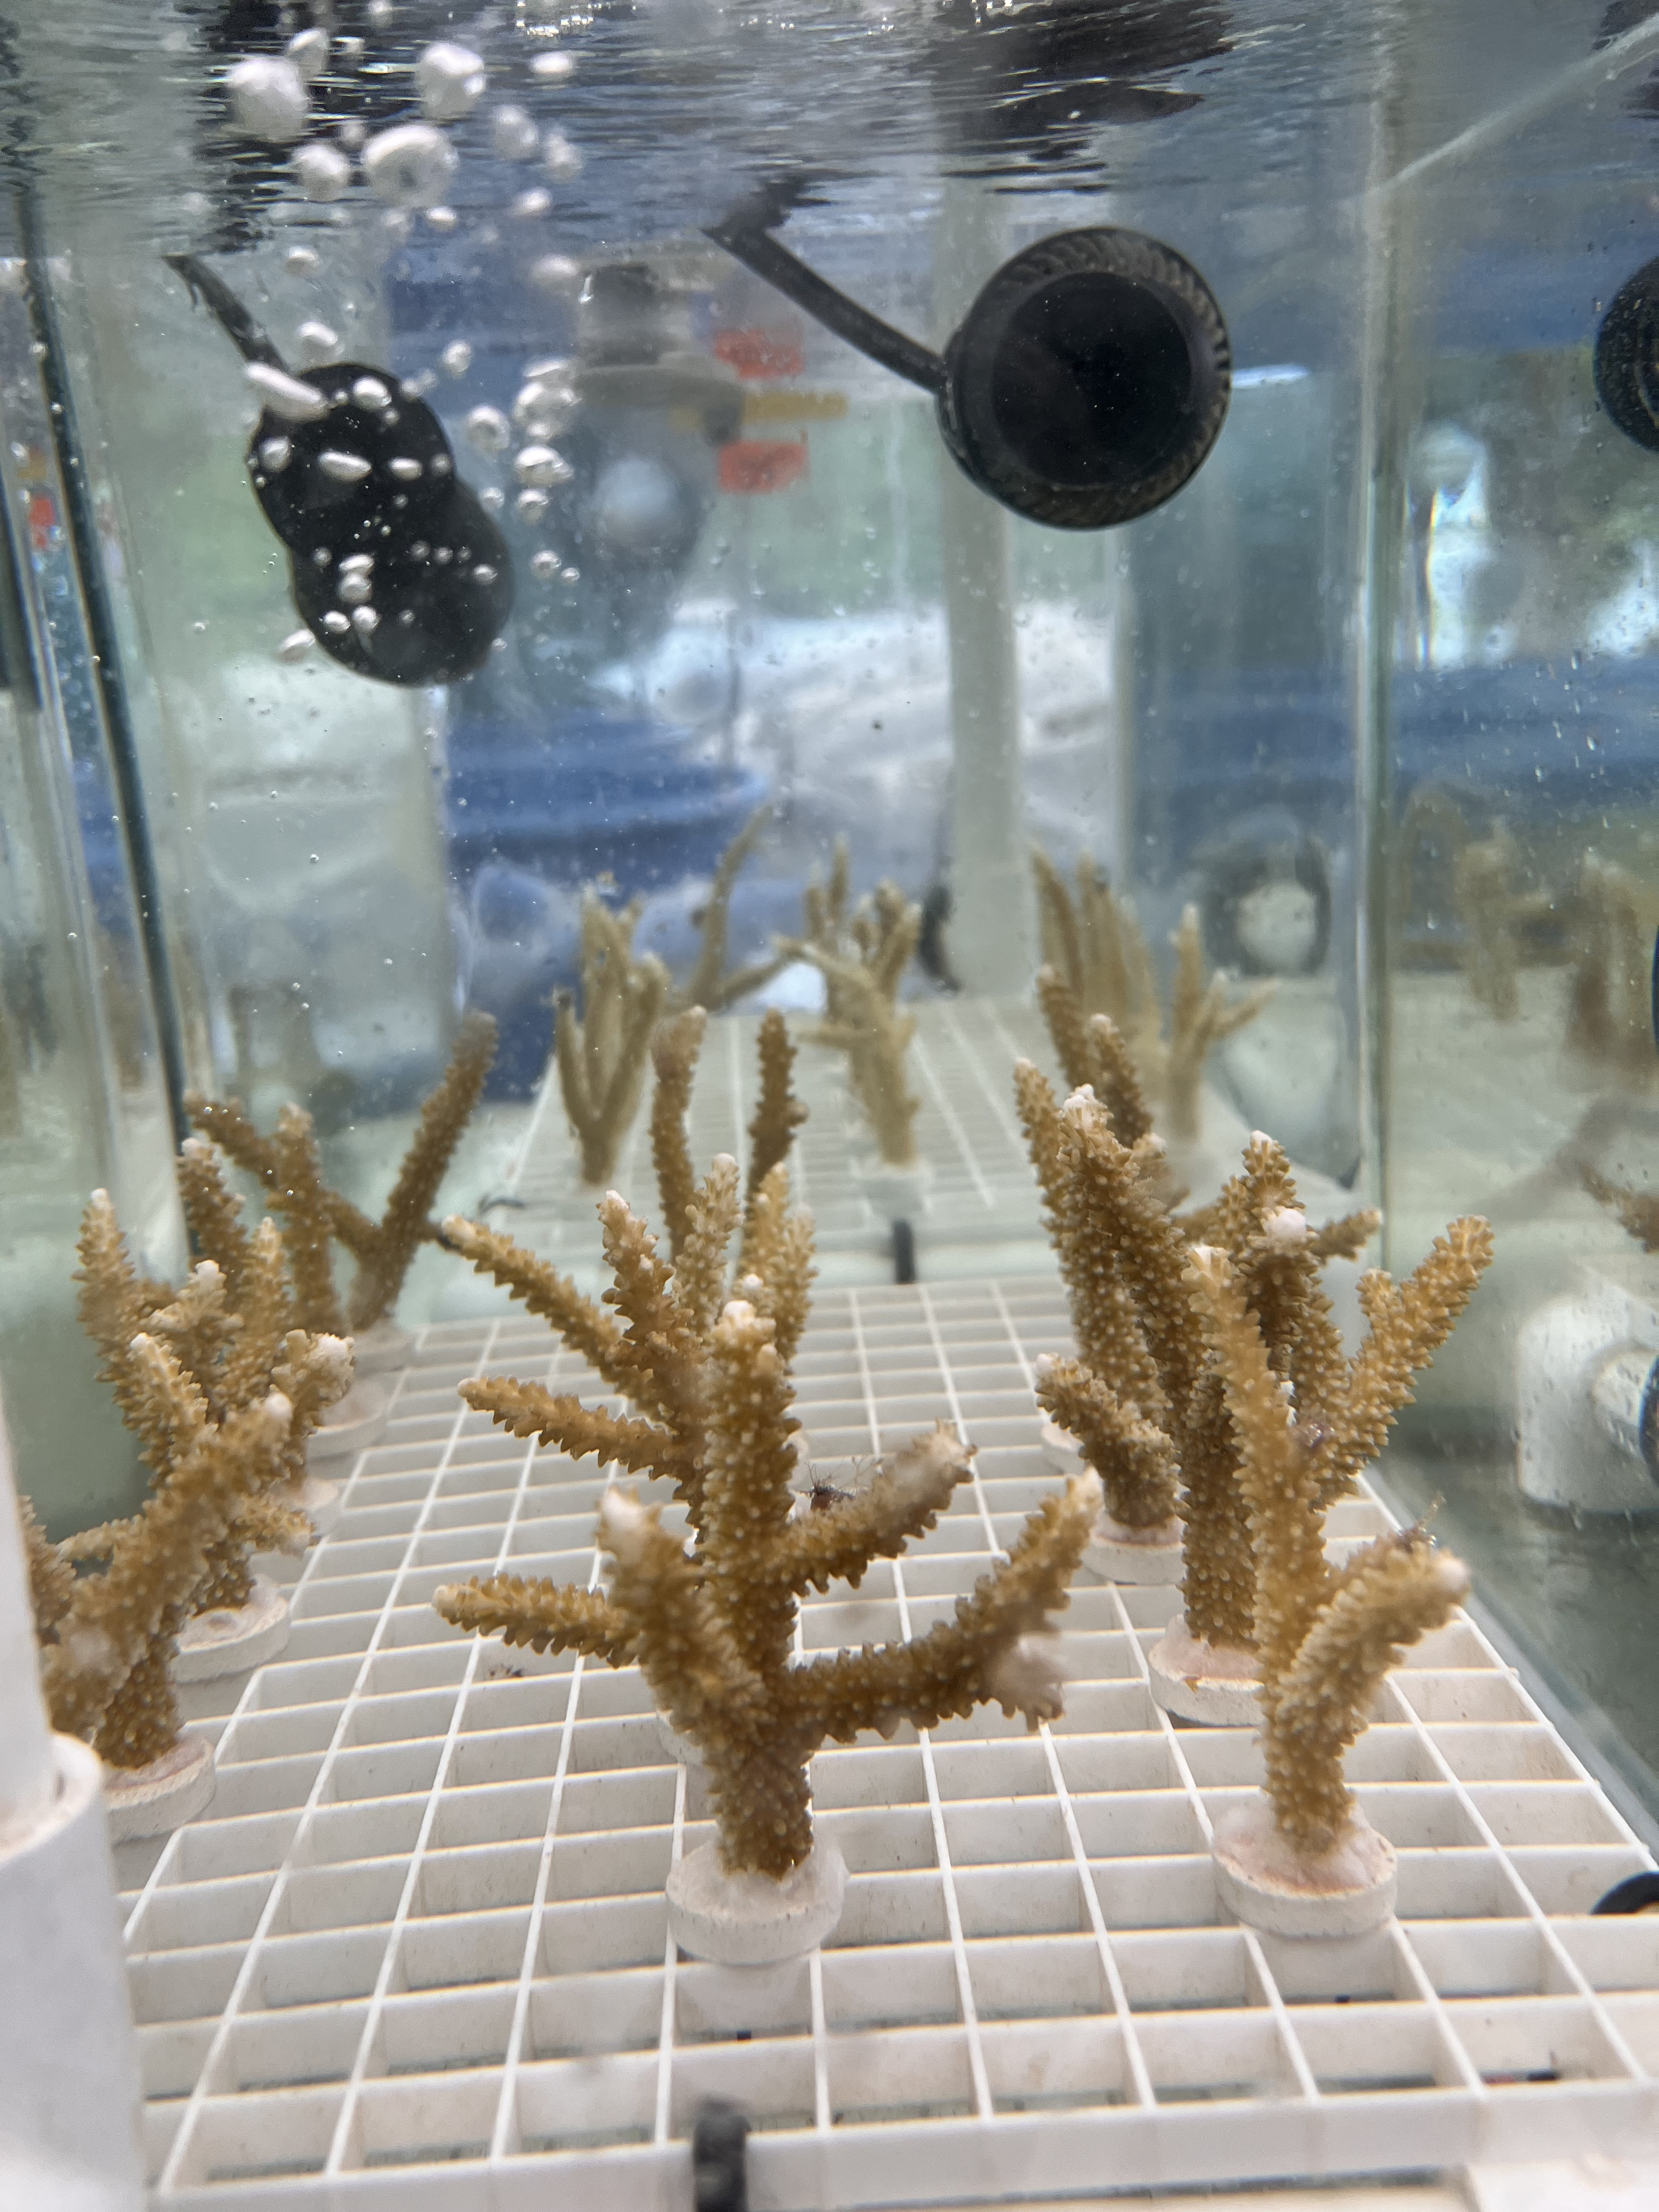
Notes:
To address these hypotheses and investigate the interplay between temperature and regeneration, I conducted a controlled mesocosm experiment in Moorea, French Polynesia, focusing on the branching coral Acropora pulchra. I started with 108 fragments of A. pulchra which I harvested from the fringing reef on the north shore of Moorea. I transported them to Gump Marine Research station where the corals acclimated for 10 days to tank conditions before they were experimentally injured and separated into ambient or elevated temperature regimes.

Slide 25

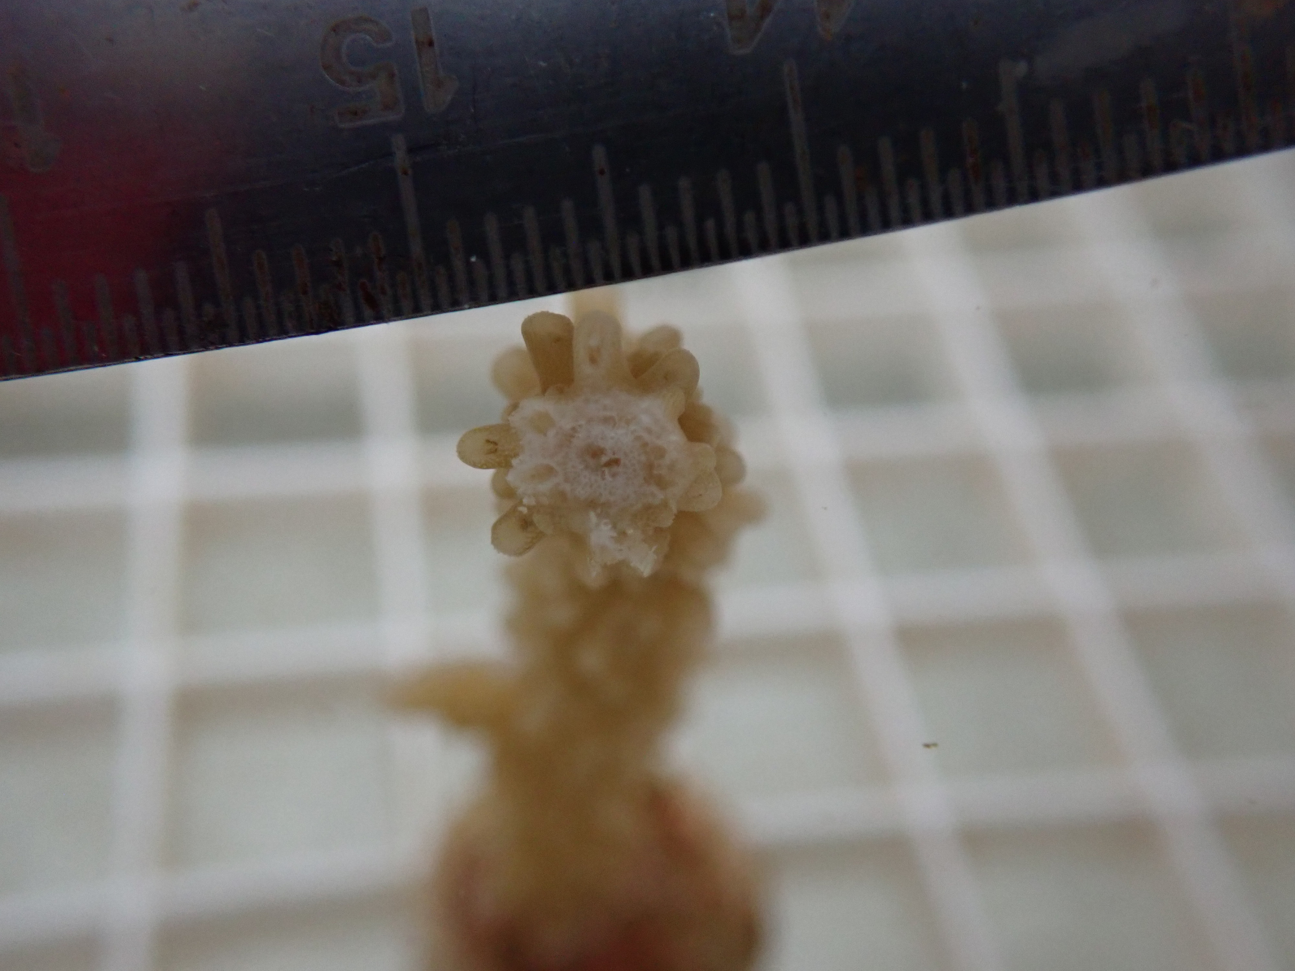
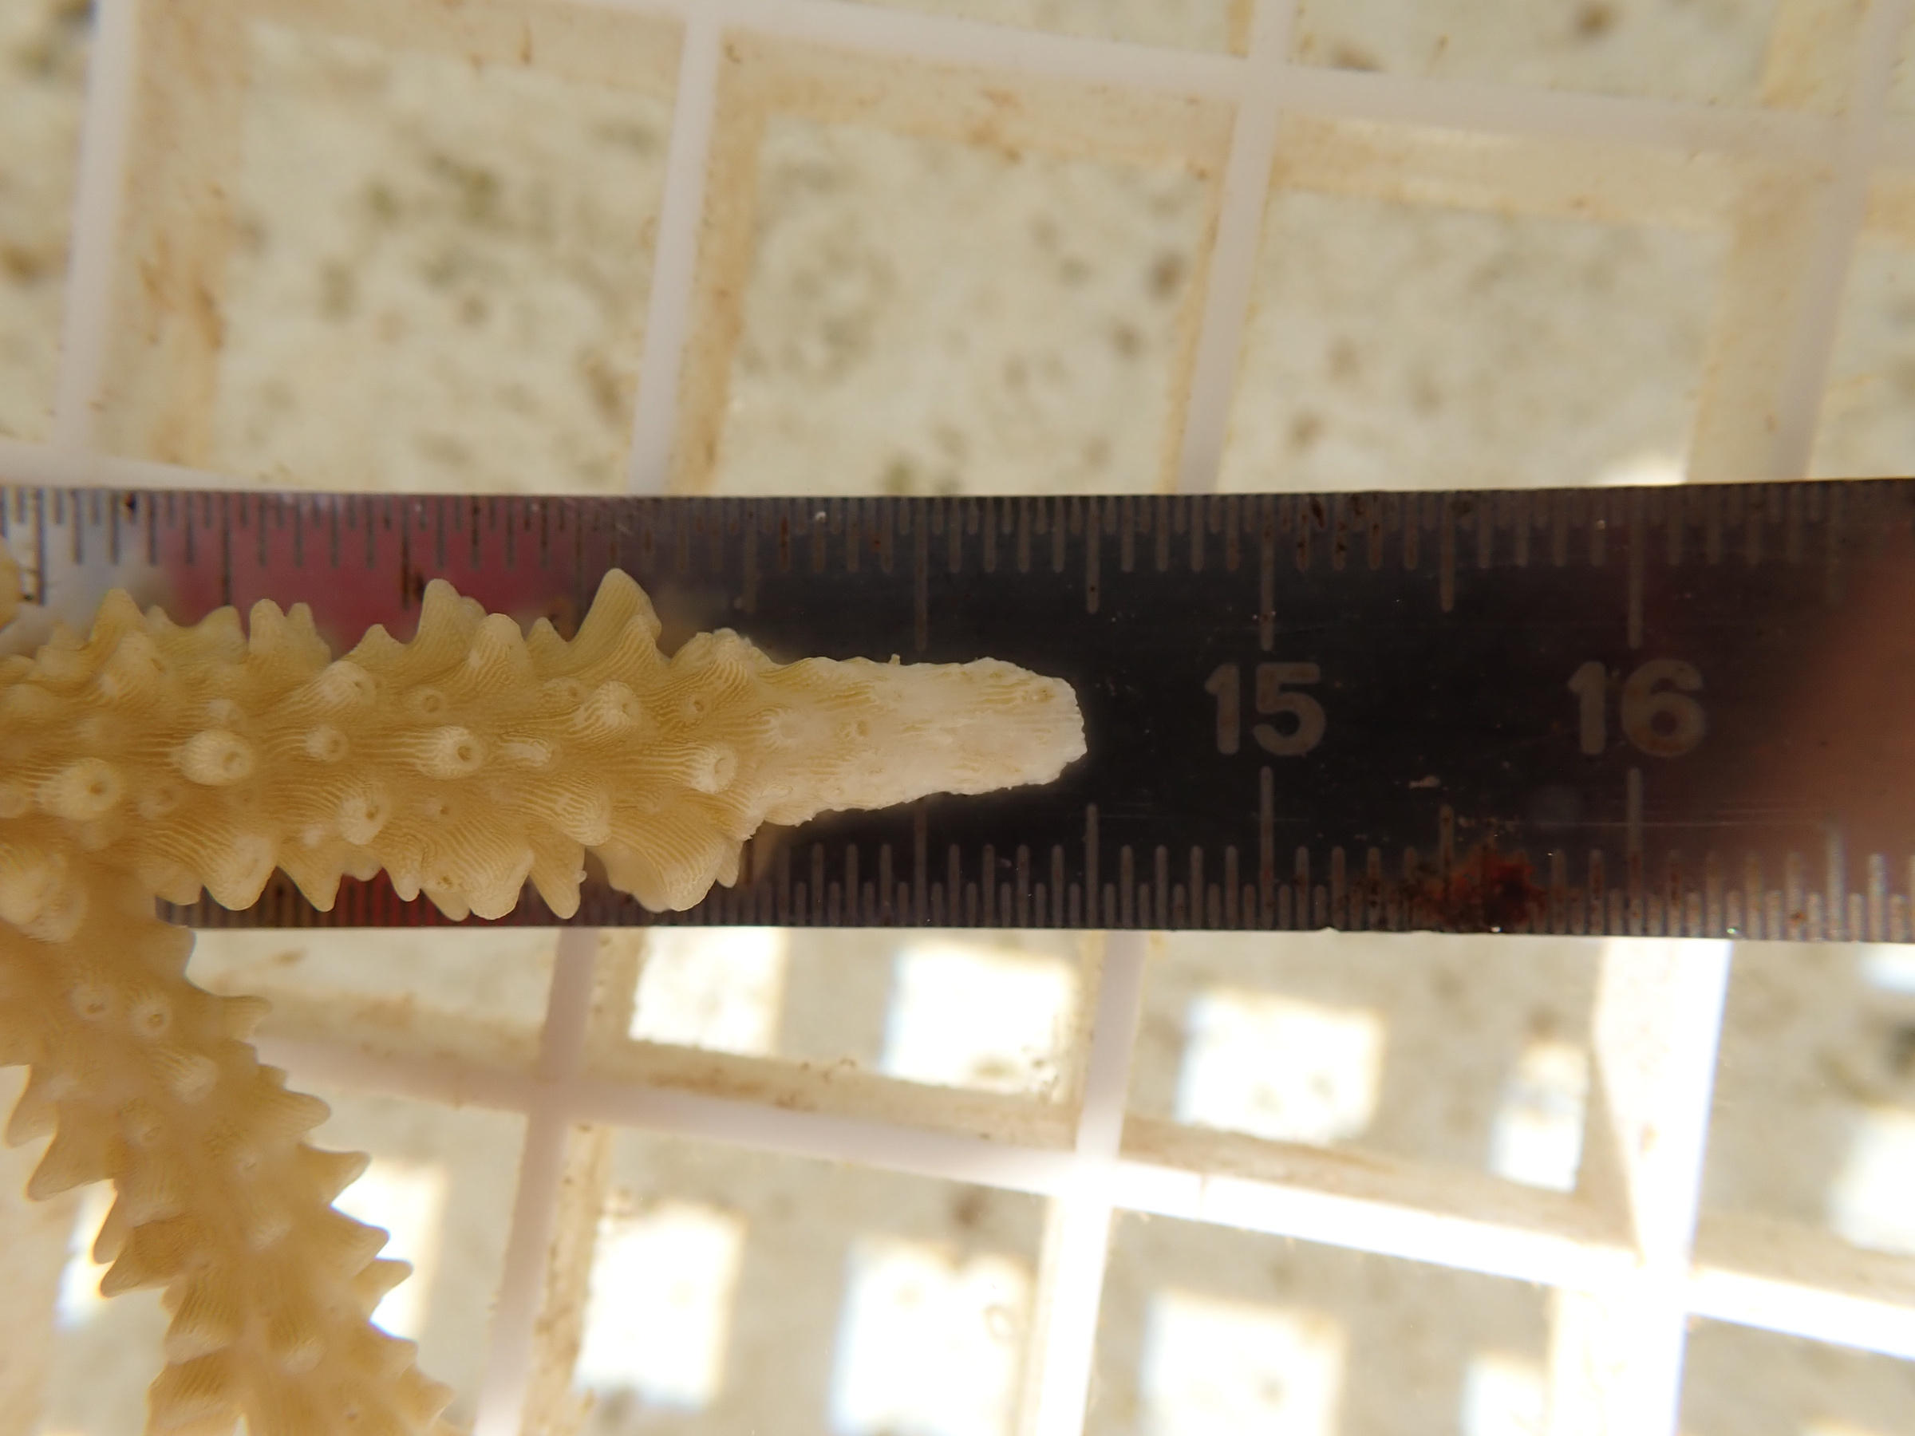
Abrasion
Fragmentation
Notes:
I subjected the corals to one of two distinct types of injuries: superficial abrasions, similar to a predation bite, and skeletal fragmentation, similar to breakage by wave action. Wound characteristics that differentiated these injuries were that the abrasions wounds were larger in surface area, but had residual pieces of tissue within the wound. The fragmentation wounds removed significantly more skeleton, but the resulting wound area was smaller, and did not appear to have residual tissue within the wound site.
I then exposed injured corals to either ambient (27.86℃) or elevated (29.51℃°) seawater conditions to assess the impact of thermal stress as the corals regenerated.
Throughout the experiment, we monitored various metrics of coral health and performance, including coral metabolism, photosynthesis, photosynthetic efficiency, growth, and regeneration. The experiment lasted for 19 days, and we collected data for each of these response variables at three intervals post injury, day 1, 10 and 19.
In the early days of this experiment I discovered a coral pest, a kind of flatworm that munches on Acropora in my experimental tanks, which I promptly removed, but ultimately, I had to remove a subset of corals from the analysis, so my final sample size was 71 corals.

Slide 26
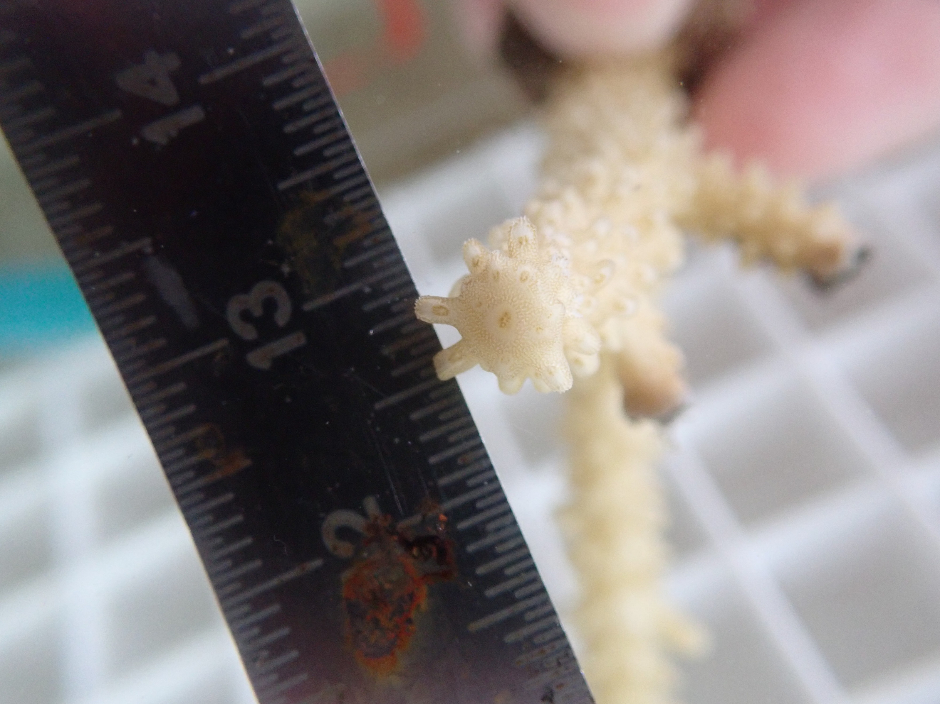
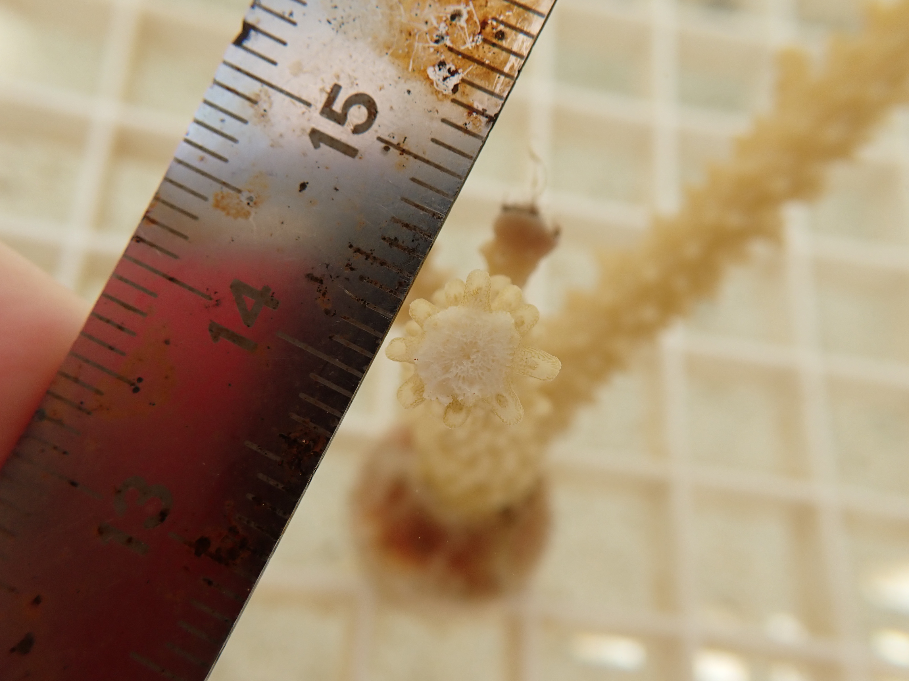
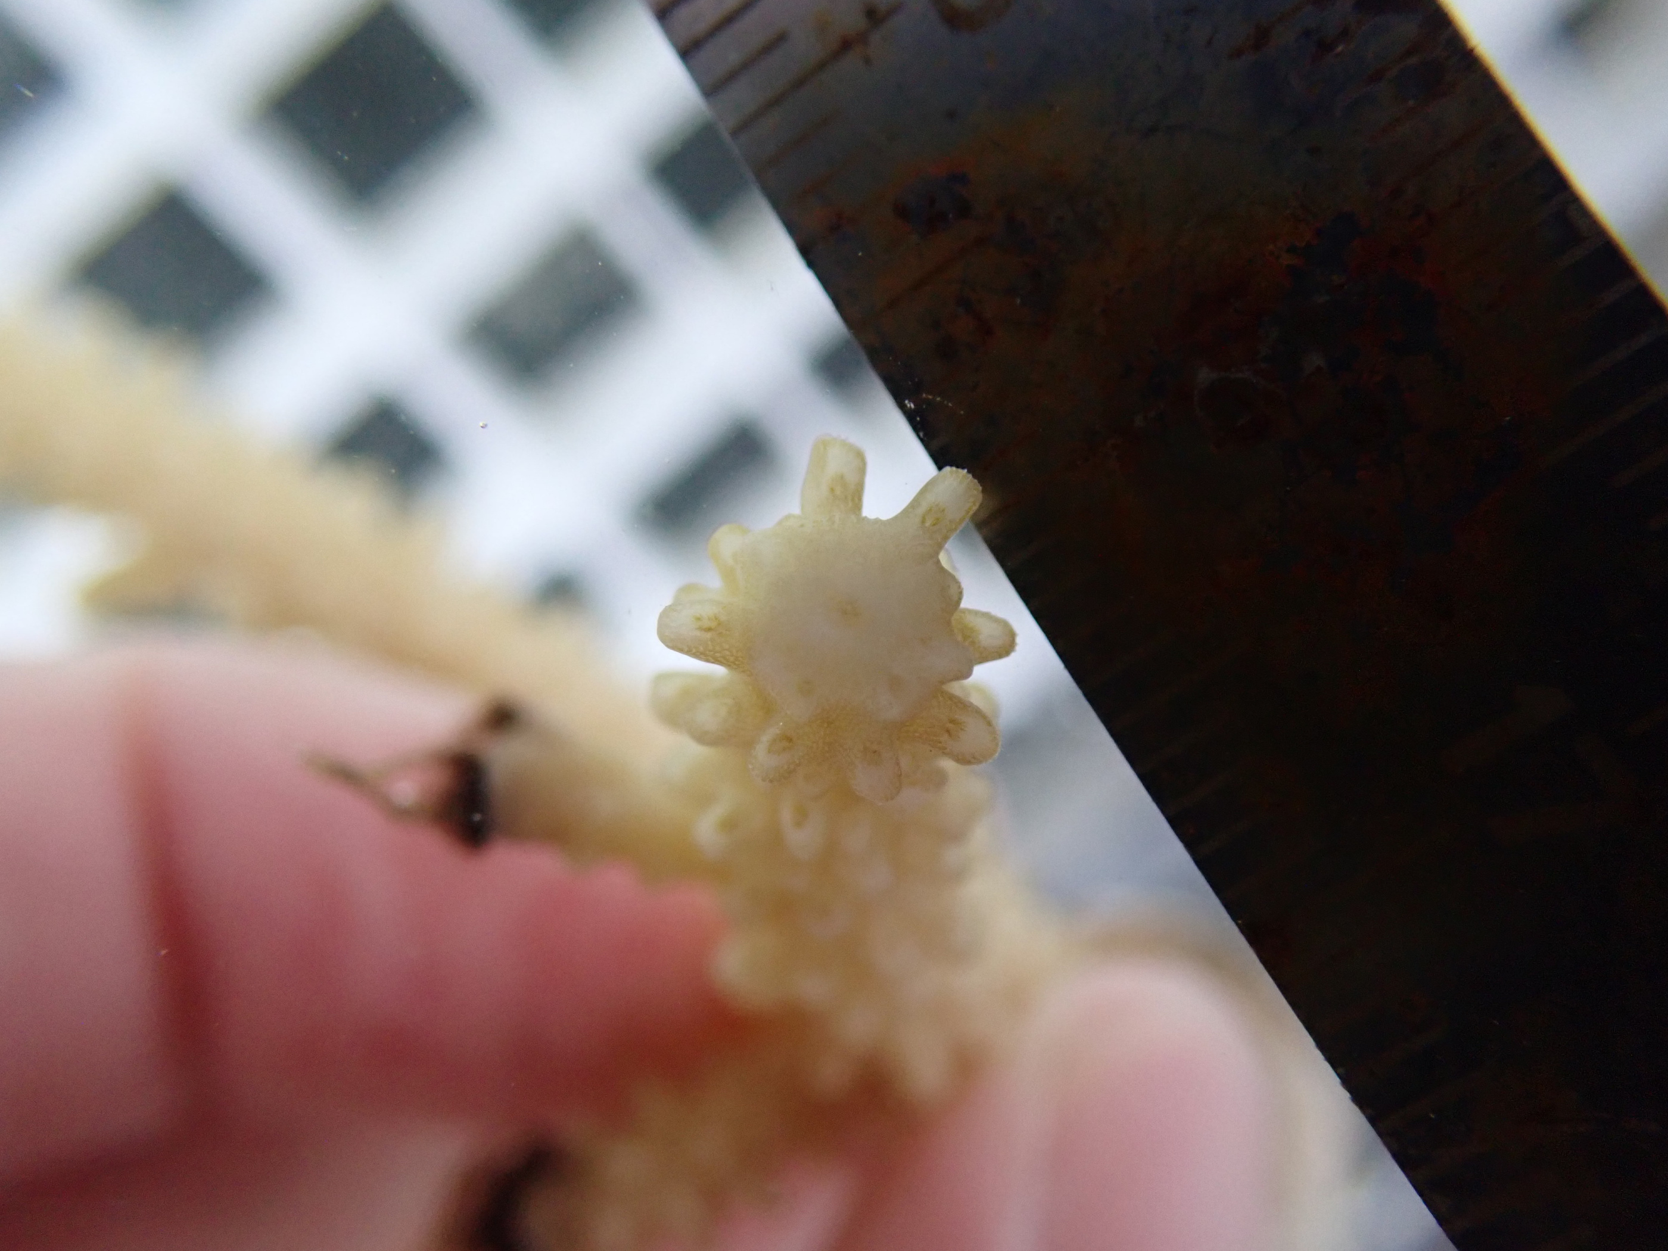
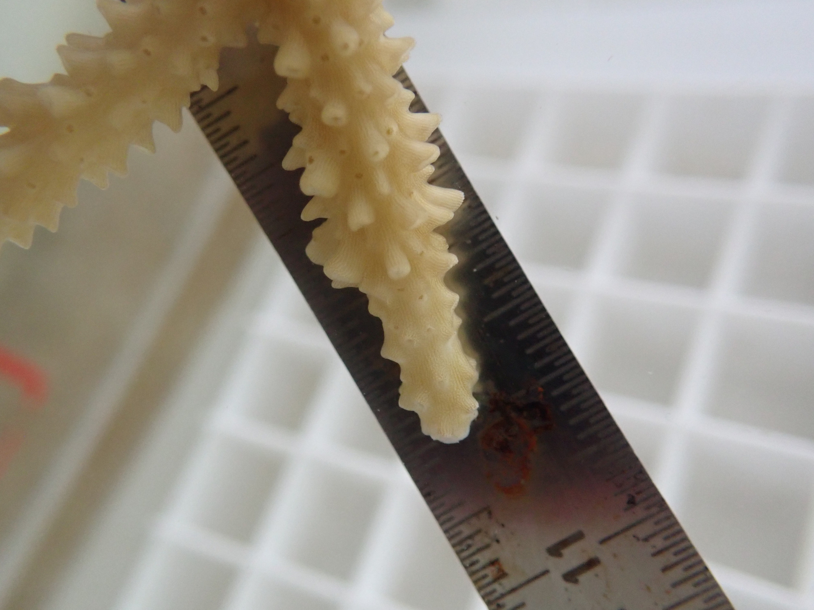
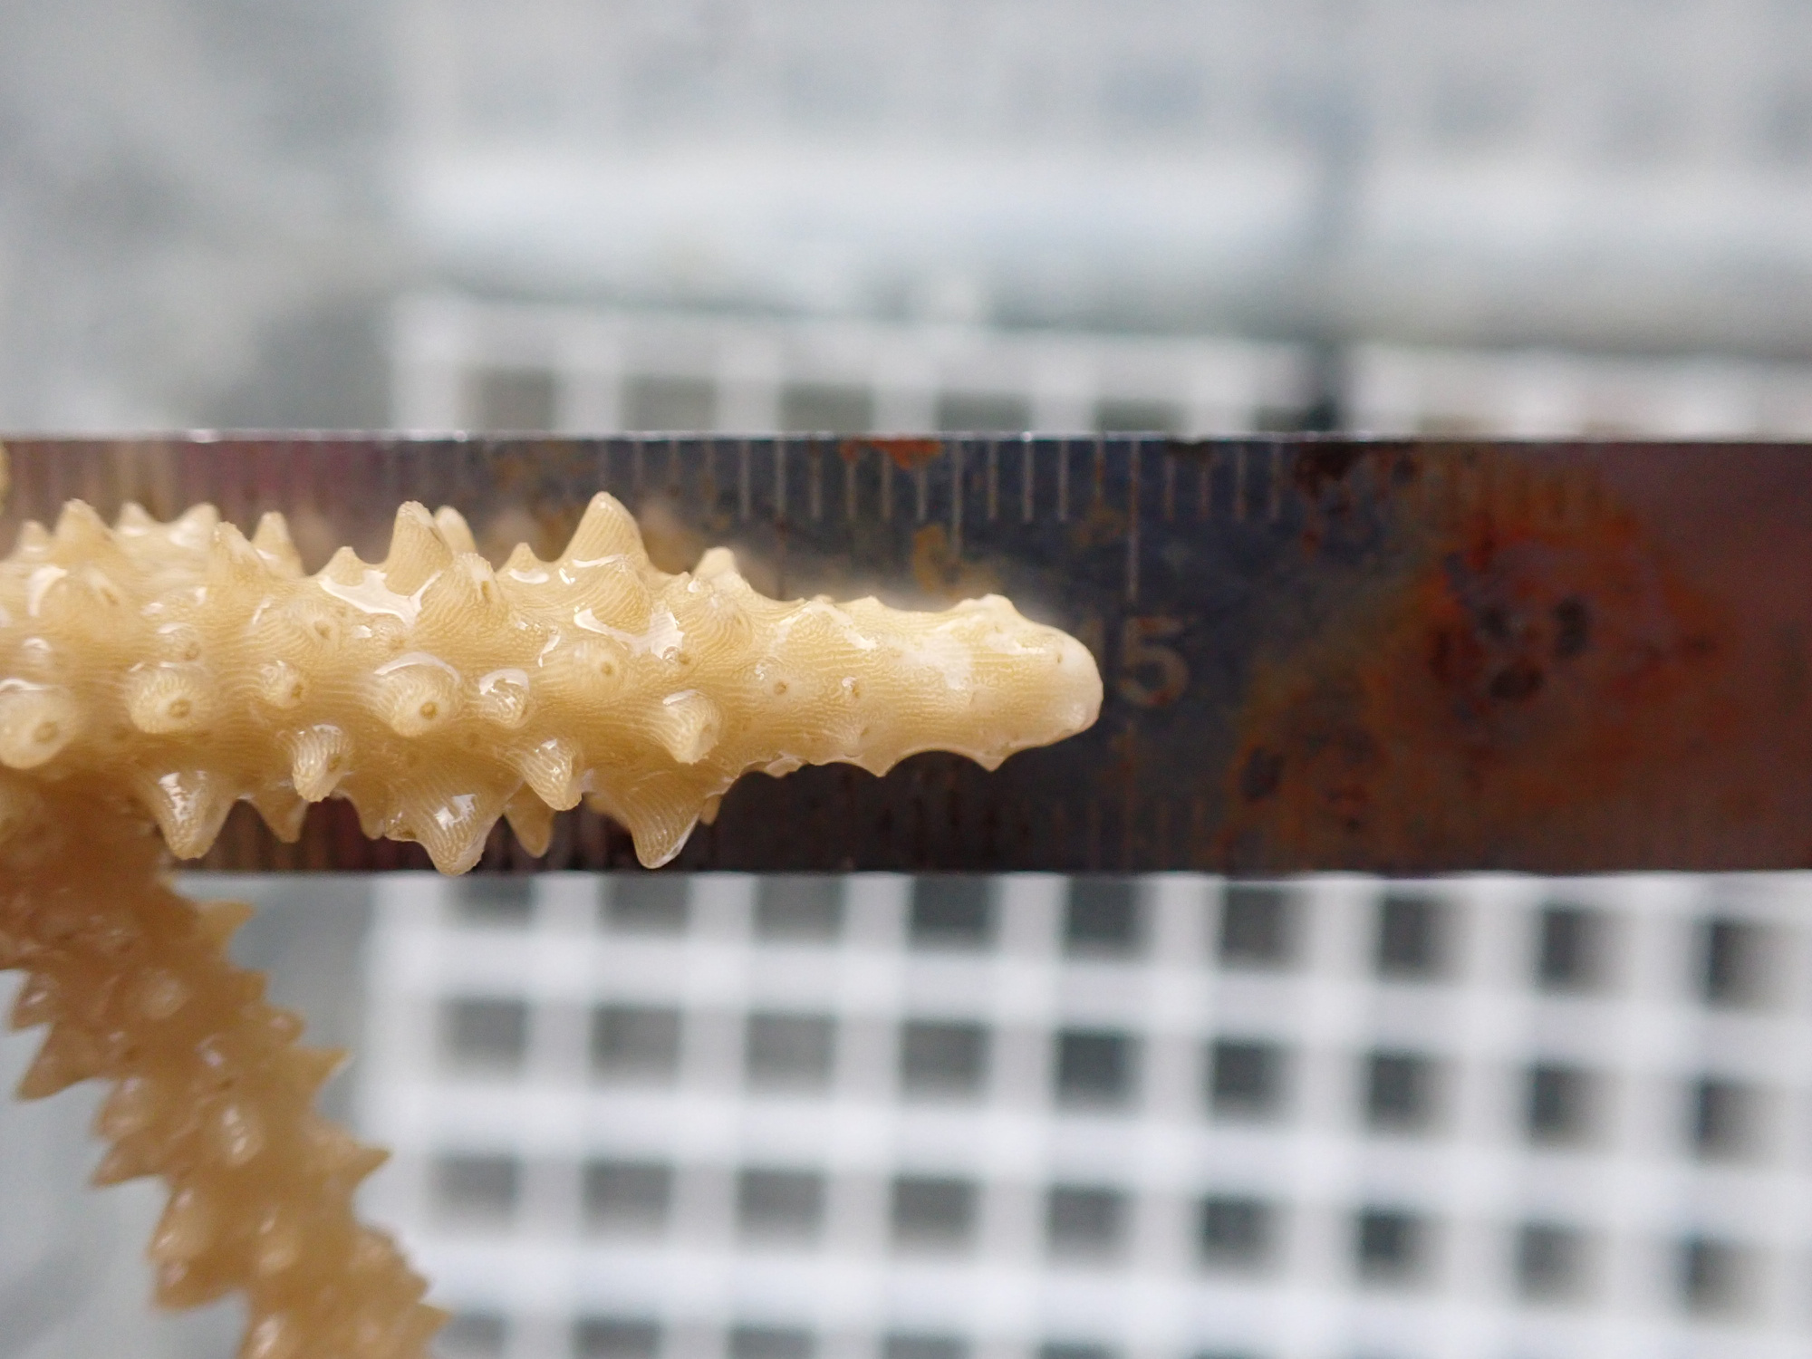
sf
sf
sf
Day 1
sf
10
Day 19
Day 10
Fragmentation
New tissue
New polyps
Abrasion
Notes:
I want to show you more up close what the wounds looked like at each interval I collected data, day 1, day 10, and day 19. The wound created by fragmentation is in the top row, you can see by day 19 this coral had regenerated new tissue across the wound site and it has also regenerated new polyps. Over all, we had 100% survival and nearly all corals displayed complete regeneration. Furthermore, we did not detect effects of temperature on regeneration. However, we did detect that tissue regen occurred sooner in abrasion wounds, and I suspect this is the phoenix effect in action.

Slide 27
Acropora pulchra regeneration is robust to injury and elevated temperature.
Notes:
Okay, that’s good news, let’s look at another response variable to understand how regeneration is so robust.

Slide 28
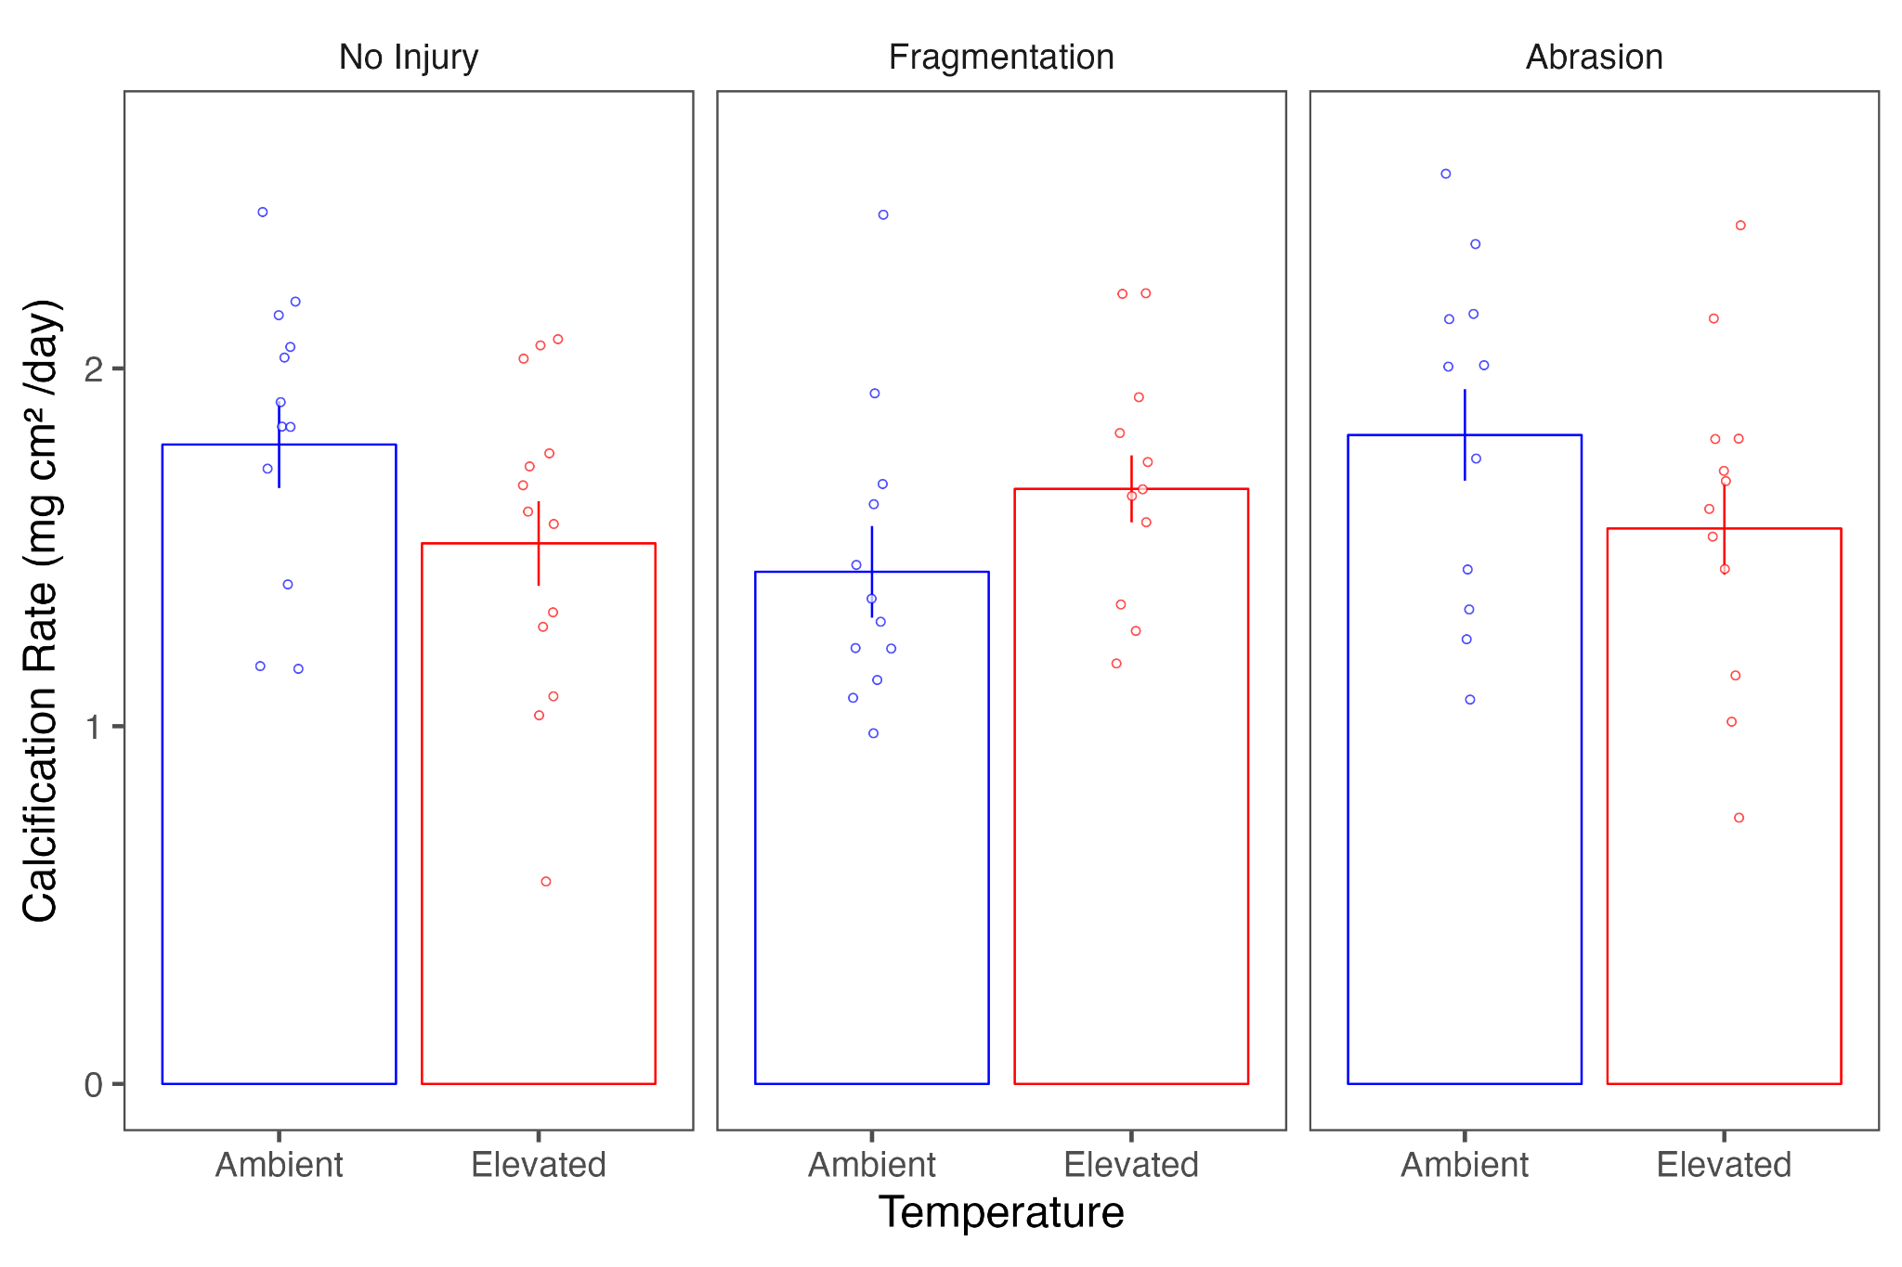
Notes:
Okay, that’s good news, let’s look at another response variable to understand how regeneration is so robust. The figure I’m going to show you is growth rate across treatments, this is the main process that I predicted regeneration would compete for energy with. On the y axis is calcification rate which is just a fancy term for growth, it is how much new skeleton a coral is laying down under it’s tissue in mg normalized to the entire surface area of the coral and divided by day to get a daily rate. So first let’s look at the control corals, the ones who were not injured at all which is in this leftmost panel, if elevated temperature was adding stress to the coral energetic budget, we would expect to see a lower growth rate in heat treated corals…. No that wasn’t the case, interesting growth rates between treatments are basically the same, the mean rate is even slightly higher for corals at ambient temperature. Let’s look at our injured corals, the ones that were simultaneously using energy to regenerate wounds. Elevated temperature did not seem to lower growth in injured corals, perhaps with the additional costs of regeneration, we’ll see lowered growth over all, and maybe even lower growth in the elevated temperature treatment. That also what not the case! Growth rates are very similar to the non-injured corals, and at elevated temperature mean growth rates are slightly higher for fragmented corals and slightly lower in abrasion corals, although these differences are not statistically different.

Slide 29
Acropora pulchra regeneration and growth is robust to injury and elevated temperature.
Notes:
Okay so from the results I just shared, we can see that both regeneration and growth are super robust to injury and elevated temperature. To get a more clear picture of how this is happening, we can look directly at the processes which are fueling regeneration and growth.

Slide 30
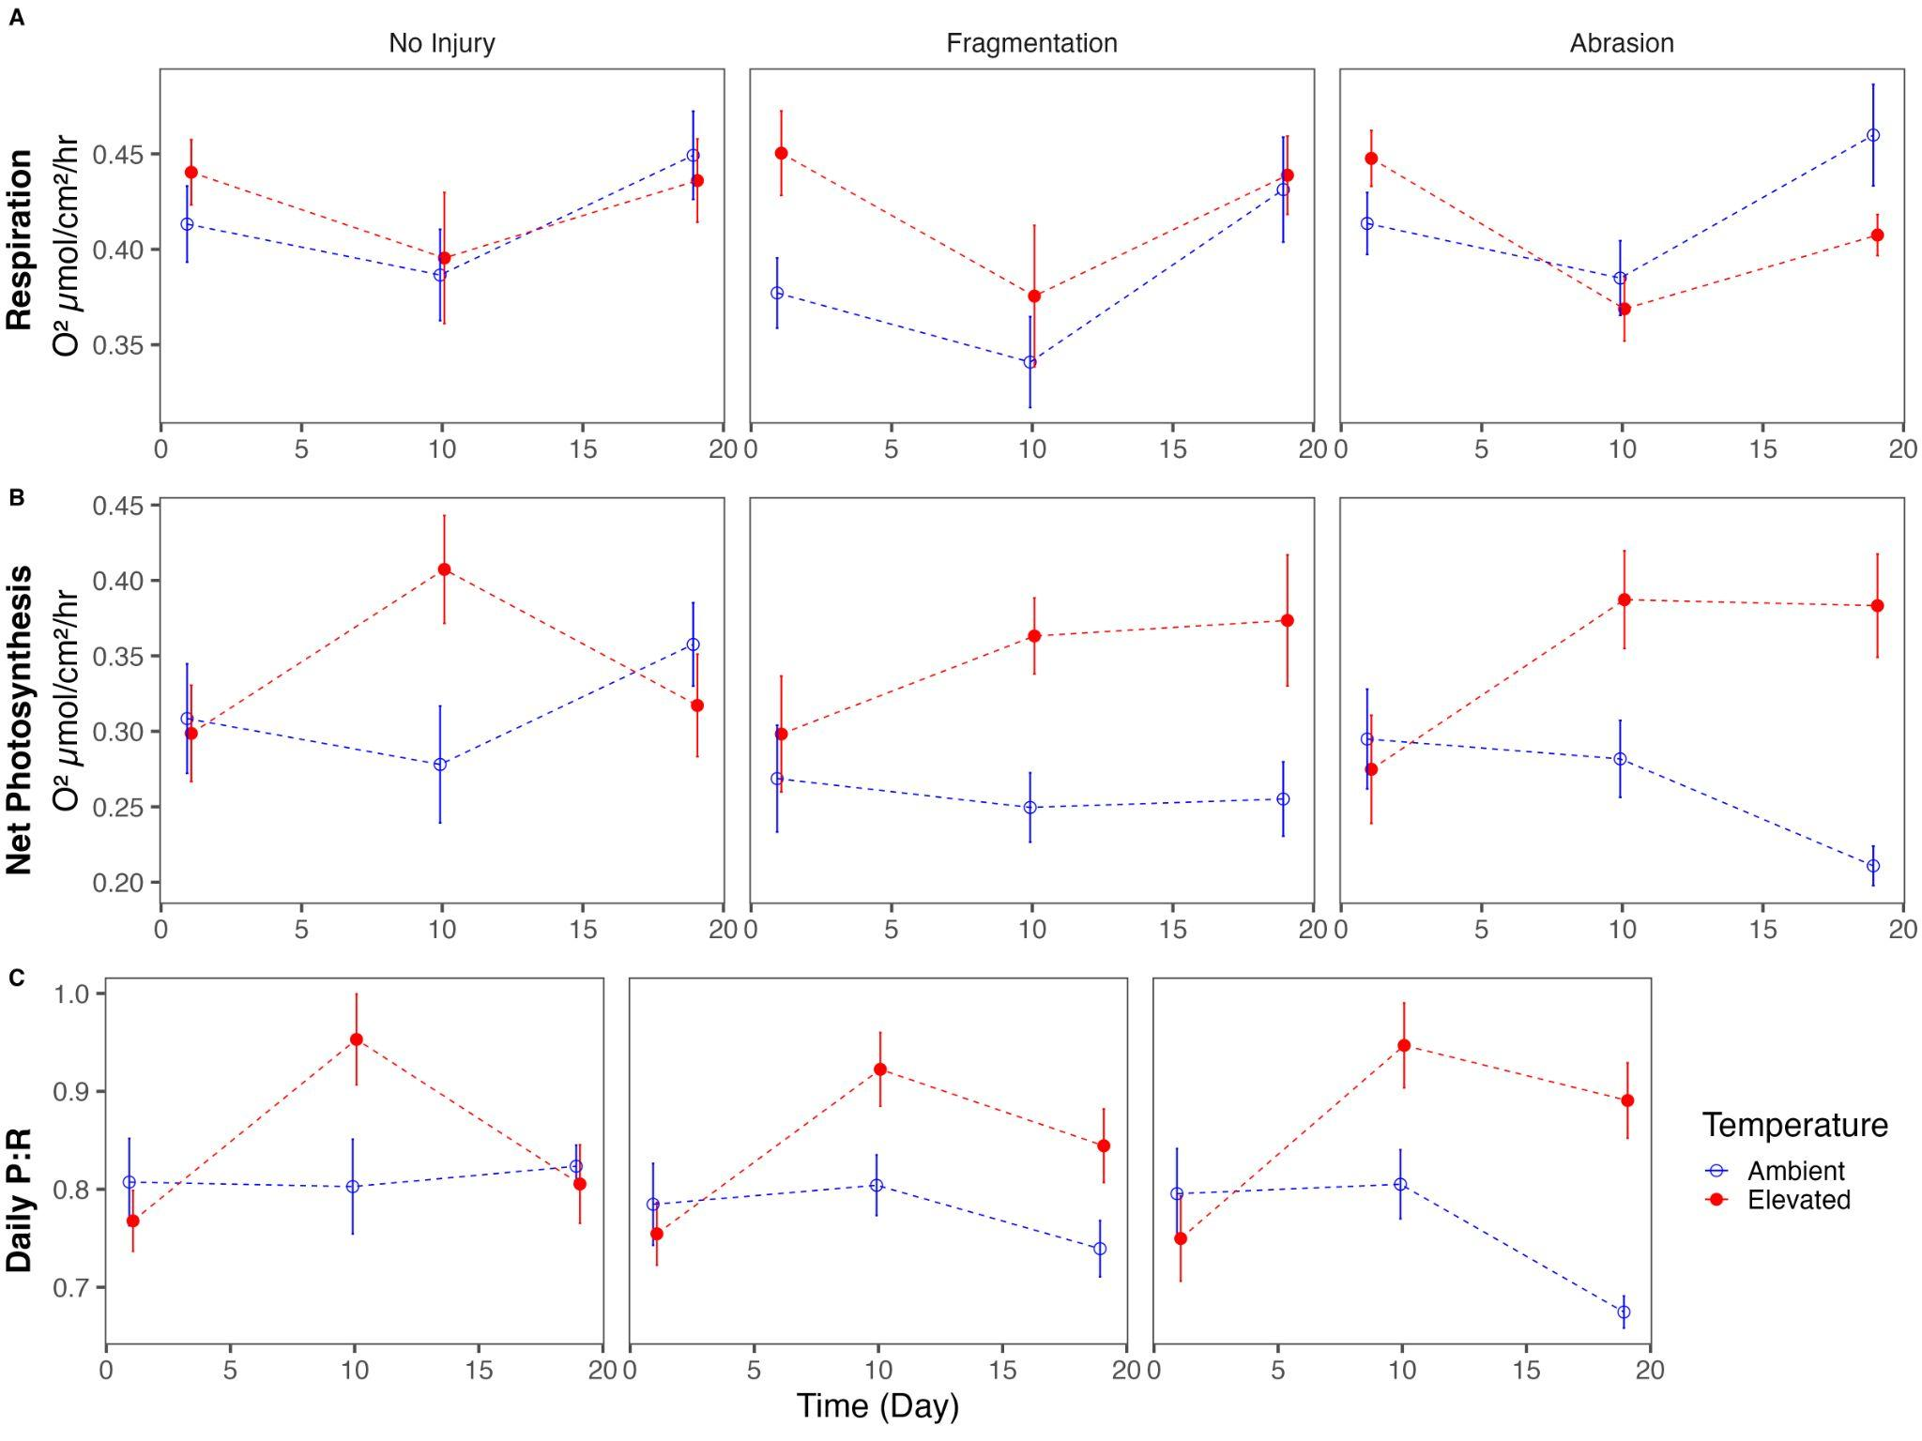
Notes:
Elevated temperatures positively influenced net photosynthesis (P_{Net}) and daily productivity (P:R) in A. pulchra, particularly for injured corals. The response to elevated temperatures was most pronounced in abraded corals, which showed the greatest increase in P_{Net} and P:R compared to fragmented or control (uninjured) corals. Despite initial increases in respiration rates at elevated temperatures, these rates declined over time, indicating that injured corals could sustain higher productivity without a corresponding increase in metabolic costs. This suggests that elevated temperatures may enhance a coral's energy acquisition and overall productivity, especially in the context regeneration.

Slide 31
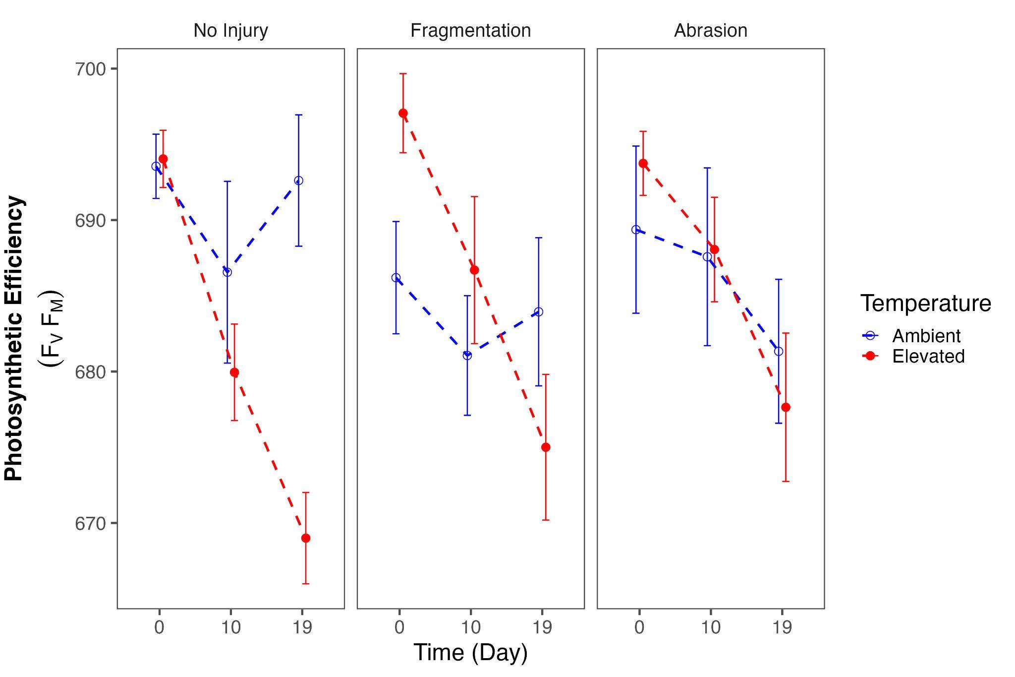
Notes:
Algal symbiont performance can be measured by photosynthetic efficiency (F_{v}F_{m}), or the maximum dark-adapted quantum yield of PSII (Maxwell and Johnson, 2000). Sustained decreases in F_{v}F_{m} are interpreted as photoinhibitory damage in response to environmental stressors primarily temperature stress. Elevated temperatures negatively affected the photosynthetic efficiency (F_{v}F_{m}) of A. pulchra over time. Specifically, F_{v}F_{m} decreased more significantly in corals exposed to elevated temperatures compared to those in ambient temperatures, with the greatest decline observed in control (uninjured) corals. Overall, elevated temperatures led to a 3% drop in F_{v}F_{m}, highlighting the potential stress impact on the photosynthetic machinery of corals under heat stress conditions.

Slide 32
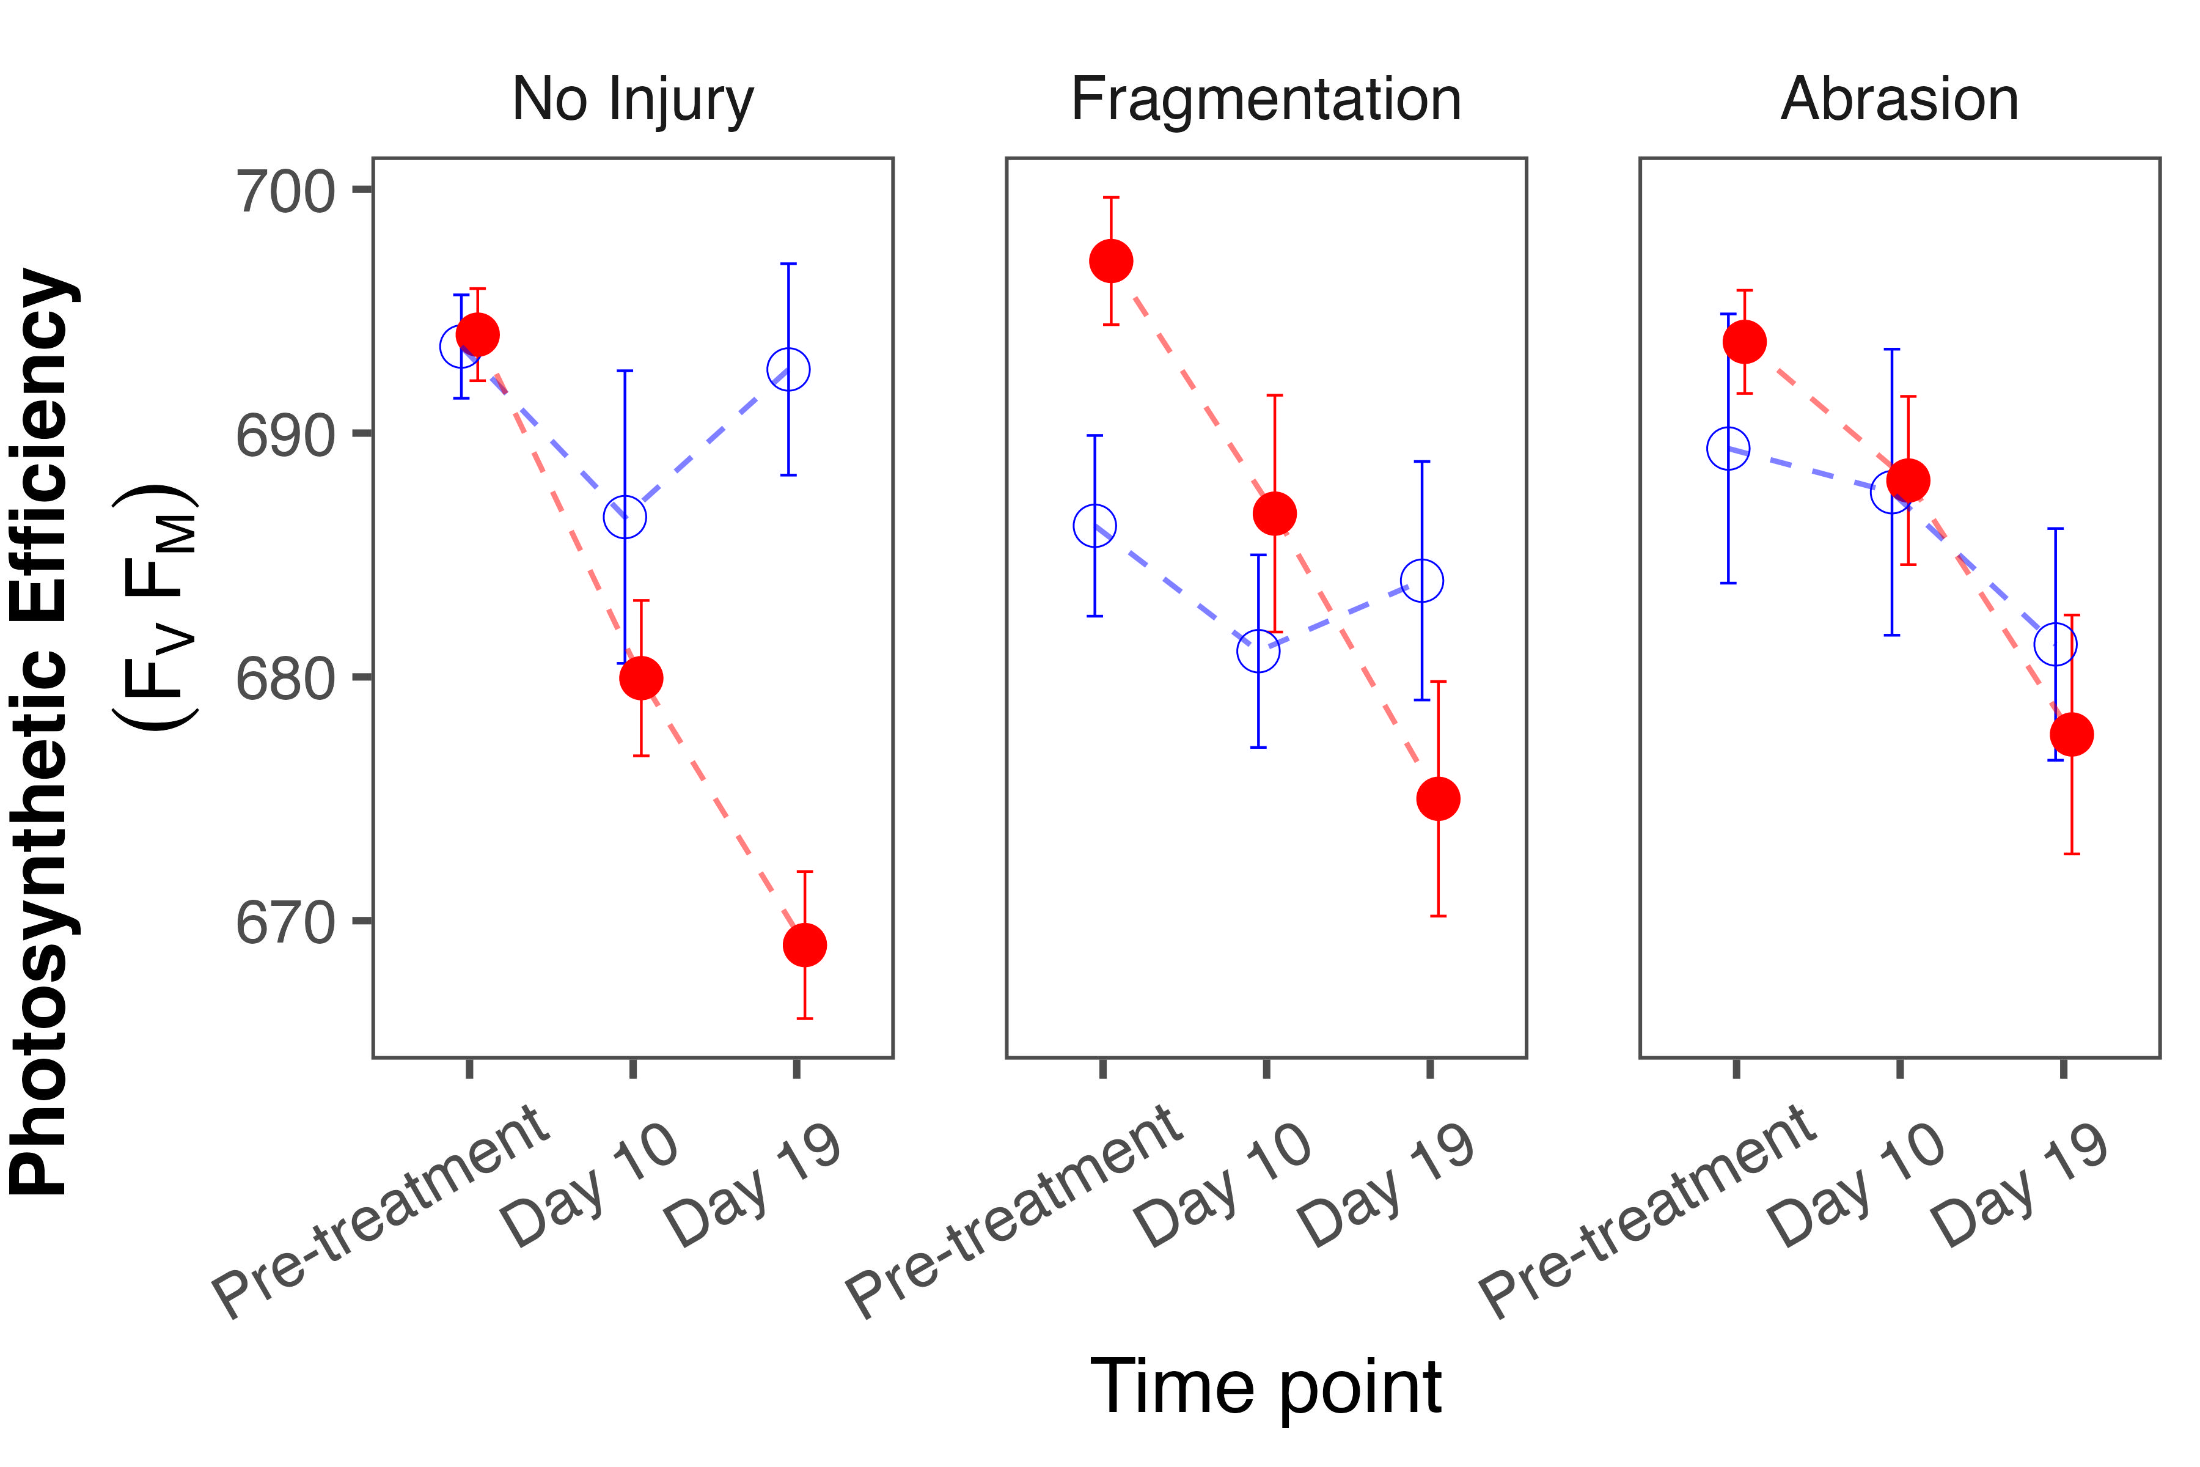
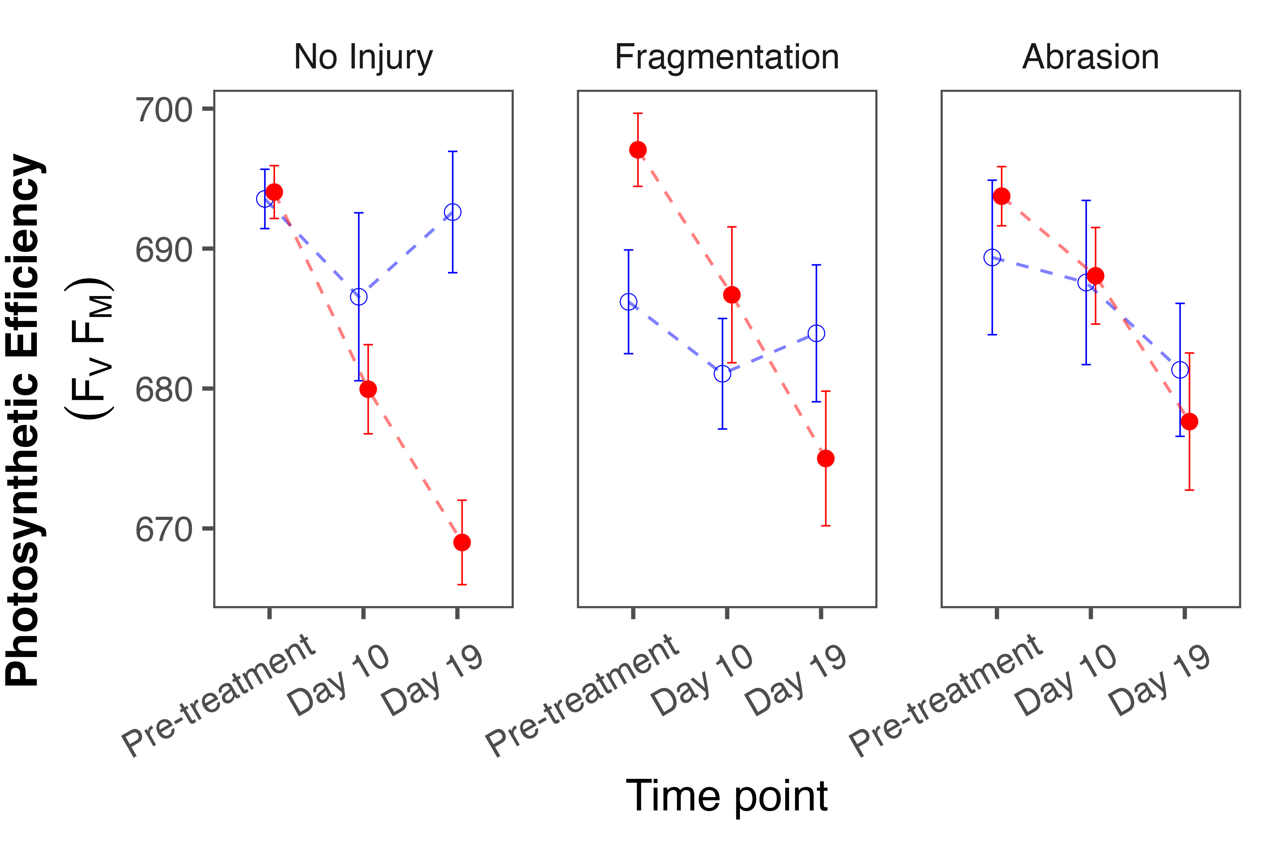
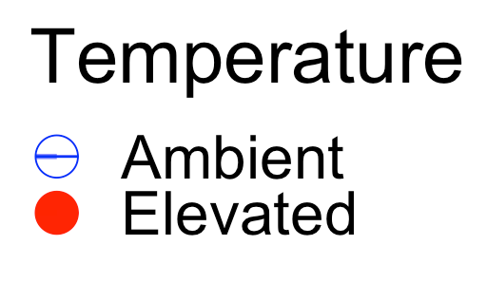
Notes:
Algal symbiont performance can be measured by photosynthetic efficiency (F_{v}F_{m}), or the maximum dark-adapted quantum yield of PSII (Maxwell and Johnson, 2000). Sustained decreases in F_{v}F_{m} are interpreted as photoinhibitory damage in response to environmental stressors primarily temperature stress. Elevated temperatures negatively affected the photosynthetic efficiency (F_{v}F_{m}) of A. pulchra over time. Specifically, F_{v}F_{m} decreased more significantly in corals exposed to elevated temperatures compared to those in ambient temperatures, with the greatest decline observed in control (uninjured) corals. Overall, elevated temperatures led to a 3% drop in F_{v}F_{m}, highlighting the potential stress impact on the photosynthetic machinery of corals under heat stress conditions.

Slide 33
H1: Regenerative capacity decreases under warmer temperatures
H2: Regenerative capacity is dependent on wound characteristics.
H3: Regeneration comes at the cost of growth.
Regeneration was robust at warmer temperature.
Tissue regeneration was faster for abrasion wounds, but ultimately regeneration was completed for both injury types.
Maintained high growth rates across treatments.
Notes:
Let’s now revisit my hypotheses. I hypothesized that regenerative capacity would decrease under warming conditions. I found that this was not the case for A. pulchra in this experiment, as there was no effect of temperature on regeneration. However, our respirometry results suggest that the dynamics of energy acquisition do depend on temperature.
I hypothesized that regenerative capacity is dependent on wound characteristics, however A. pulchra was robust to both injury types in this experiment despite the different wound characteristics they created.
Lastly, my third hypothesis was that regeneration would come at the cost of growth. A. pulchra displayed rapid growth rates throughout this experiment regardless of treatment.

Slide 34
Notes:
This study aimed to address how warming oceans influence the balance between energy acquisition, allocation, and utilization during coral regeneration. We found that Acropora pulchra exhibits a robust capacity for tissue regeneration under heat stress, without compromising growth rates. We also found that elevated temperatures enhanced productivity, suggesting that these corals can effectively allocate energy towards regeneration even under thermal stress. However, this increased productivity came at the cost of reduced photosynthetic efficiency, indicating potential long-term stress on the coral-algal symbiosis.

Slide 35
Conclusions
1. High regenerative capacity underscores coral resilience
2. Robust mechanisms of energy acquisition, allocation, and utilization drive the success of coral regeneration.
3. The interplay between warming and symbiosis is dynamic, but it is crucial in anticipating how coral resilience will be altered by climate change
4. Selection of coral species and genotypes for restoration should target corals with high regenerative capacity like A. pulchra
Notes:
My overall conclusions for this study are that 1. High regenerative capacity underscores coral resilience, 2) Robust mechanisms of energy acquisition, allocation, and utilization drive the success of coral regeneration, 3) The interplay between warming and symbiosis is dynamic, but it is crucial in anticipating how coral resilience will be altered by climate change and 4) this knowledge can inform the selection of coral species and genotypes for restoration projects, ensuring that the chosen corals possess the necessary traits to withstand thermal stress and recover from injuries. Integrating physiological insights into restoration practices will be crucial for developing effect strategies to restore and preserve coral reefs in a rapidly changing climate.

Slide 36
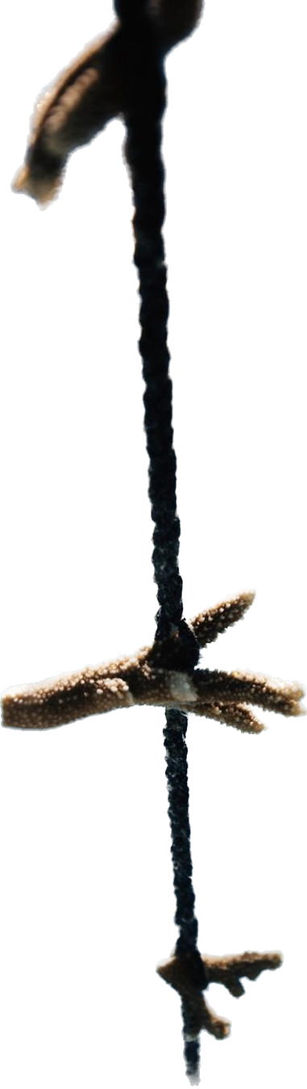
Here ninah gives thank yous and acknowledgements and cries

